Slide 1
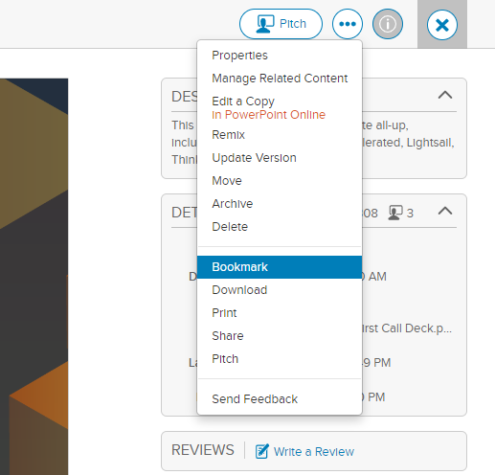
Subscribe to this deck!
Welcome to the AWS CDK First Call Deck.
Please review and rate this presentation:
Click on the star rating below in Highspot or presentation mode.
Please use the “Bookmark” function in Highspot to be alerted to of updates. Hide this slide before presenting.
DO NOT PRESENT THIS SLIDE

Slide 2
AWS CDK First Call Deck Data
Last updated: October 27, 2021– amelnyk@
Points of contact: Alexander Melnyk (amelnyk@);
Tags: #aws-cdk #iac #cloudformation #cfn
If you have any comments, ideas, or suggestions for this deck, please contact me on chime or email. Feel free to add and adjust anything you want, if you have valuable feedback please reach out so other can also benefit from that.
Please see README on the next slide
DO NOT PRESENT THIS SLIDE

Slide 3
AWS CDK First Call Deck Readme
What: AWS CDK First Call Deck Level: 300
Services Covered: AWS CloudFormation
What This Presentation Is: This presentation is a level 300 sales tool. It assumes your audience has solid knowledge of cloud computing, infrastructure as code, software delivery practices.
Target Audience: The intended audience for this deck is developers, operations leads, technical leaders with experience and/or knowledge of the cloud automation, software delivery and infrastructure engineering.
Business managers may be a part of the meeting, but this presentation should not be used for business-only audiences.
The backup slides contain deep dive into how to build custom constructs.
DO NOT PRESENT THIS SLIDE

Slide 4
AWS CDK First Call Deck Readme
DEMO
It is important to showcase the CDK capabilities in a short demo. You can find detailed instructions here:
https://github.com/am29d/cdk-serverless-demo
The demo project is up to date, please make sure to practice the demo few times before the presentation to insist on highest standards and provide good customer experience. If you have any issues with the demo ping me on chime any time.
DO NOT PRESENT THIS SLIDE

Slide 5
AWS Cloud Development Kit (CDK)
A modern way to build your AWS infrastructure
Name
Role
Notes:
Introduce yourself, state your role and how you help customers to achive their business outcomes.
Briefly introduce the topic and the structure of the presentation, setup expectation.
This slide can be use instead of ”Agenda” slide with 3 bullet points.

Slide 6
Abstractions
AWS CDK, Pulumi
Generators
Troposphere, GoFormation
Declarative
CloudFormation, Terraform
Scripted
#!/bin/bash
Manual
Wikis, Playbooks, Ask-Bob-he-knows
Notes:
In this slide we present the evolution of the tooling and processes in infrastructure provisioning.
It starts with the manual deployments where we used wikis and playbooks, which sometimes were outdated, I am sure most of us can relate to some of the projects where we had to use it. It was sometimes outdated or some details were not mentioned and we encountered situations during the provisioning which were not stated in the manual. Best way to solve it was just to ask a person who actually did it the last time of few times in the past. Best hope this perosn is not on vacation right now or still works at the company!
The next step was scripting everything in bash. It worked well until it become too complex, because bash was not designed build deployment frameworks, so it was hard to maintain. Best advise was: it worked the last time, don’t touch it!
The important next step was the introduction of infrastructure provision engines, such as AWS CloudFormation, Terraform and others. This tools would hide the complexity of state management, rollbacks, drift detection, error management. The developer would describe the infrastructure in delcarative way and hand over the description to the engine. The ease of increased the adoption of Infrastructure as code among many developers. This led to growing number of templates, which were hard to maintain in declaritavie formats such as JSON or YAML. The most missing feature in this tools was the lack of programming language capabilities.
So the next idea was to use generators. Write code that generates JSON or YAML document from classes and methods of a programming language.
And on top of that idea new tools such as AWS CDK or Pulumi emerged, that provide a set tools and a framework to create custom abstractions for cloud infrastructure.
Important: we don’t say that using JSON or YAML is the wrong way, it is different way and everybody should use the tool they are comfortable working with. CDK is simply the next step in the abstraction chain.

Slide 7
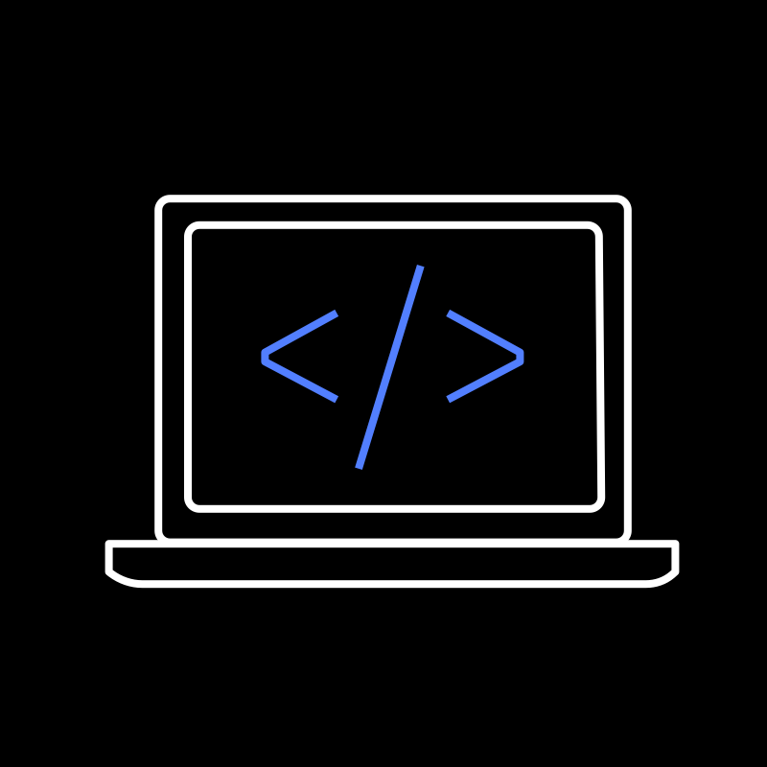
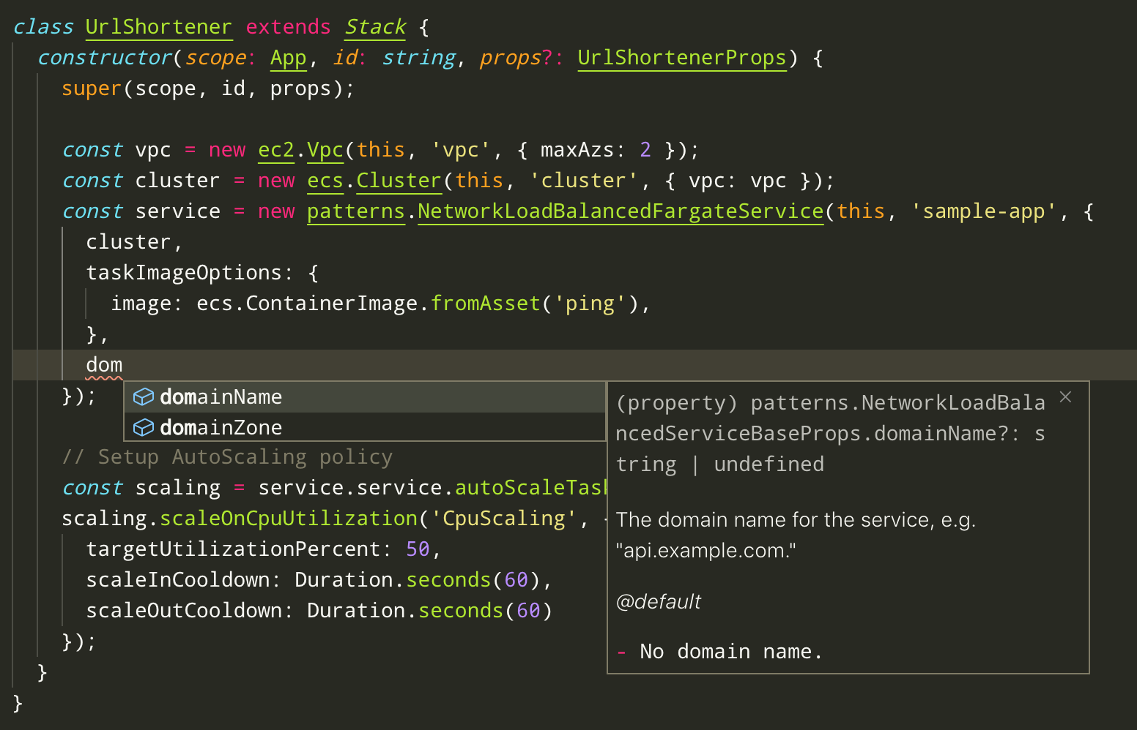



AWS Cloud Development Kit
Familiar Your language Just classes and methods
Tool Support AutoComplete Inline documentation
Abstraction Sane defaults Reusable classes
DEV PREVIEW
Notes:
The AWS Cloud Development Kit (AWS CDK) is an open source software development framework to model and provision your cloud application resources using familiar programming languages.
You can do this in different programming languages such as Python, JavaScript, TypeScript, Java or C#.
With CDK you will be much faster than with previous tools, because you work with your familiar language and concepts, classes and method, without context switch.
You also have all the tool support from the programming language, such as autocomplete, inline documentation, tests, linitng, debugger.
One of the highly requested features is the support of Golang is coming soon!
And most important part is that you are able to build your abstractions and components of the infrastructure and application. We provide many sane default values so there is no need to read a lot of documentation, but just start quickly and safe. Of course, many of this default values can be adjusted to your need.

Slide 8
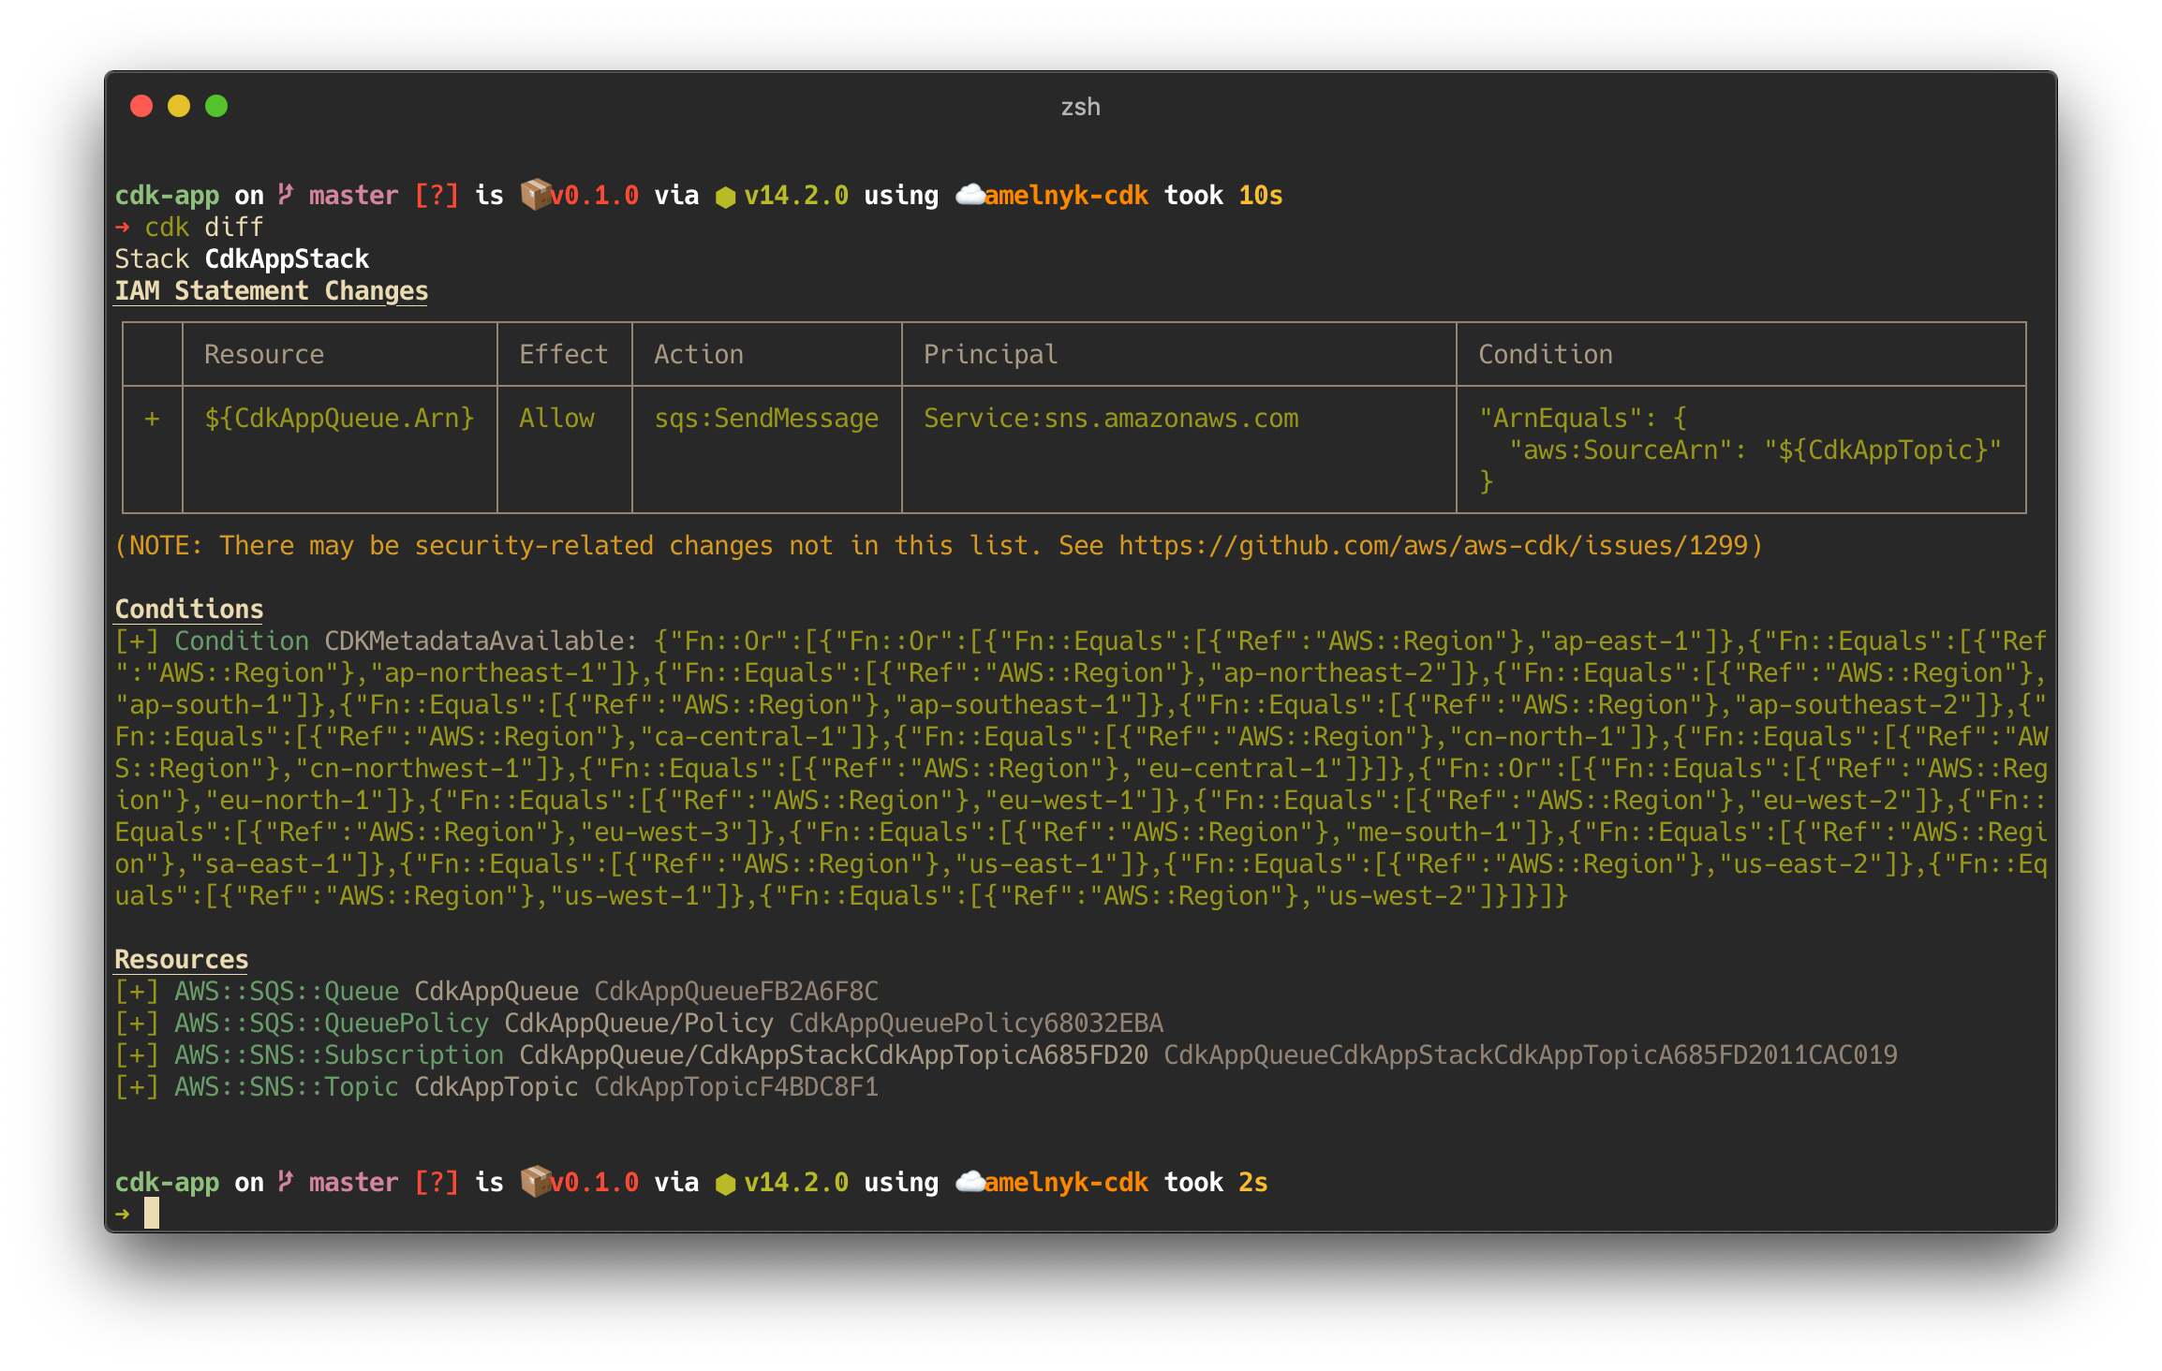

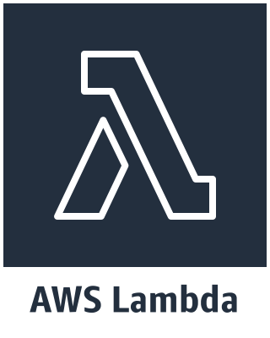
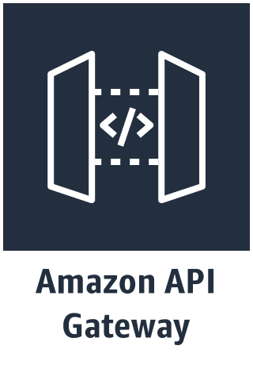
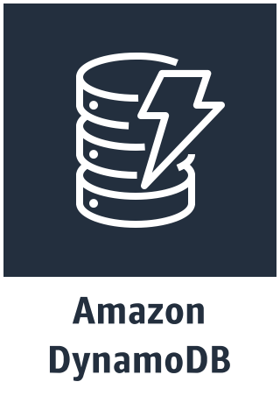
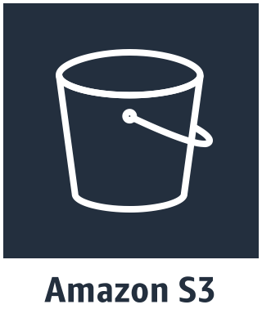
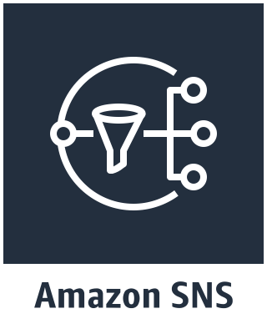
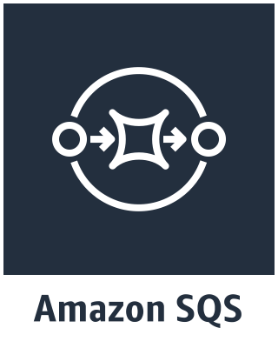
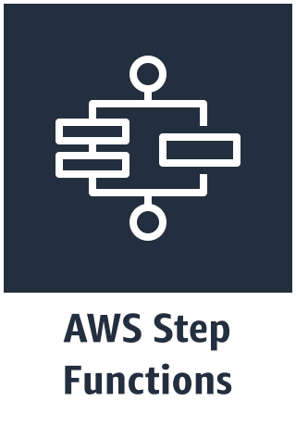

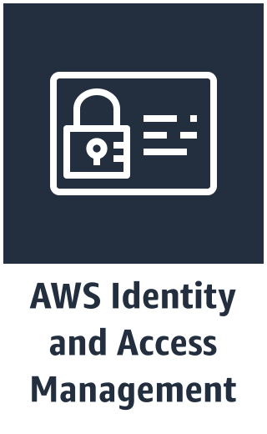
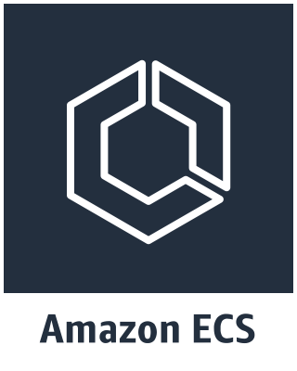
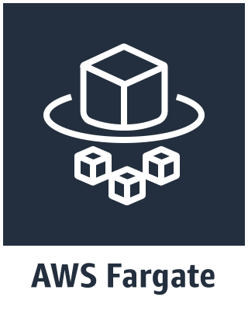
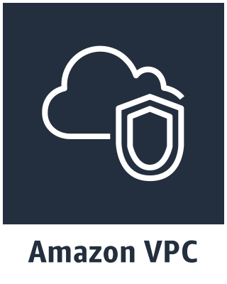
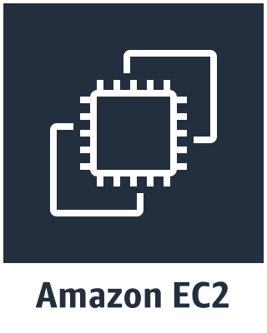
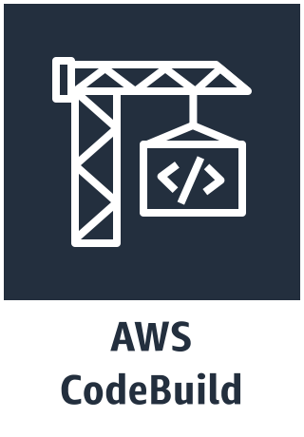
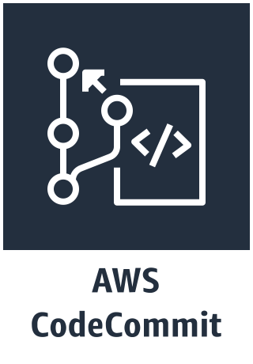
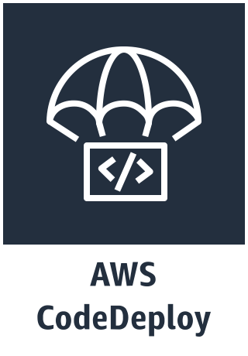
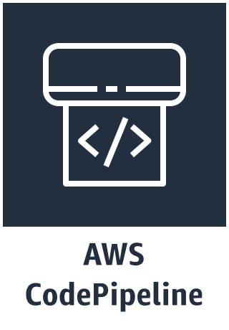

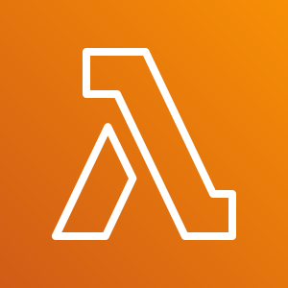

Main Components
Serverless
App Integration / Foundational Services
App
Stacks
Containers
CI/CD
Resources
Core Framework
AWS Construct Library
AWS CDK CLI
Notes:
There are three main components of CDK: the core framework, the aws construct library and the command line interface.
With the core framework you can create and structure Apps that contain one or multiple Stacks. Stacks are logical units of infrastructure which contains multiple resources and mapped 1:1 to CloudFormation Stacks. It is a good practice to divide resource into stacks that have different lifecycles: i.e. you would create one stack for Network Infrastructure such as VPC, another stack would have an Elastic Container Service Cluster, and yet another stack would be the application that is running in this cluster.
The AWS construct library is a set of components crafted by AWS to create resources for specific services. This helps to decouple libraries and use only the dependencies that you need in your project. It is also build with best practices and security conciderations, to provide good developer experience, ease of use and fast iteration cycles.
The CDK CLI helps to interact with the core framework to initialise project structure, inspect differences between deployments and deploy easily to AWS.

Slide 9
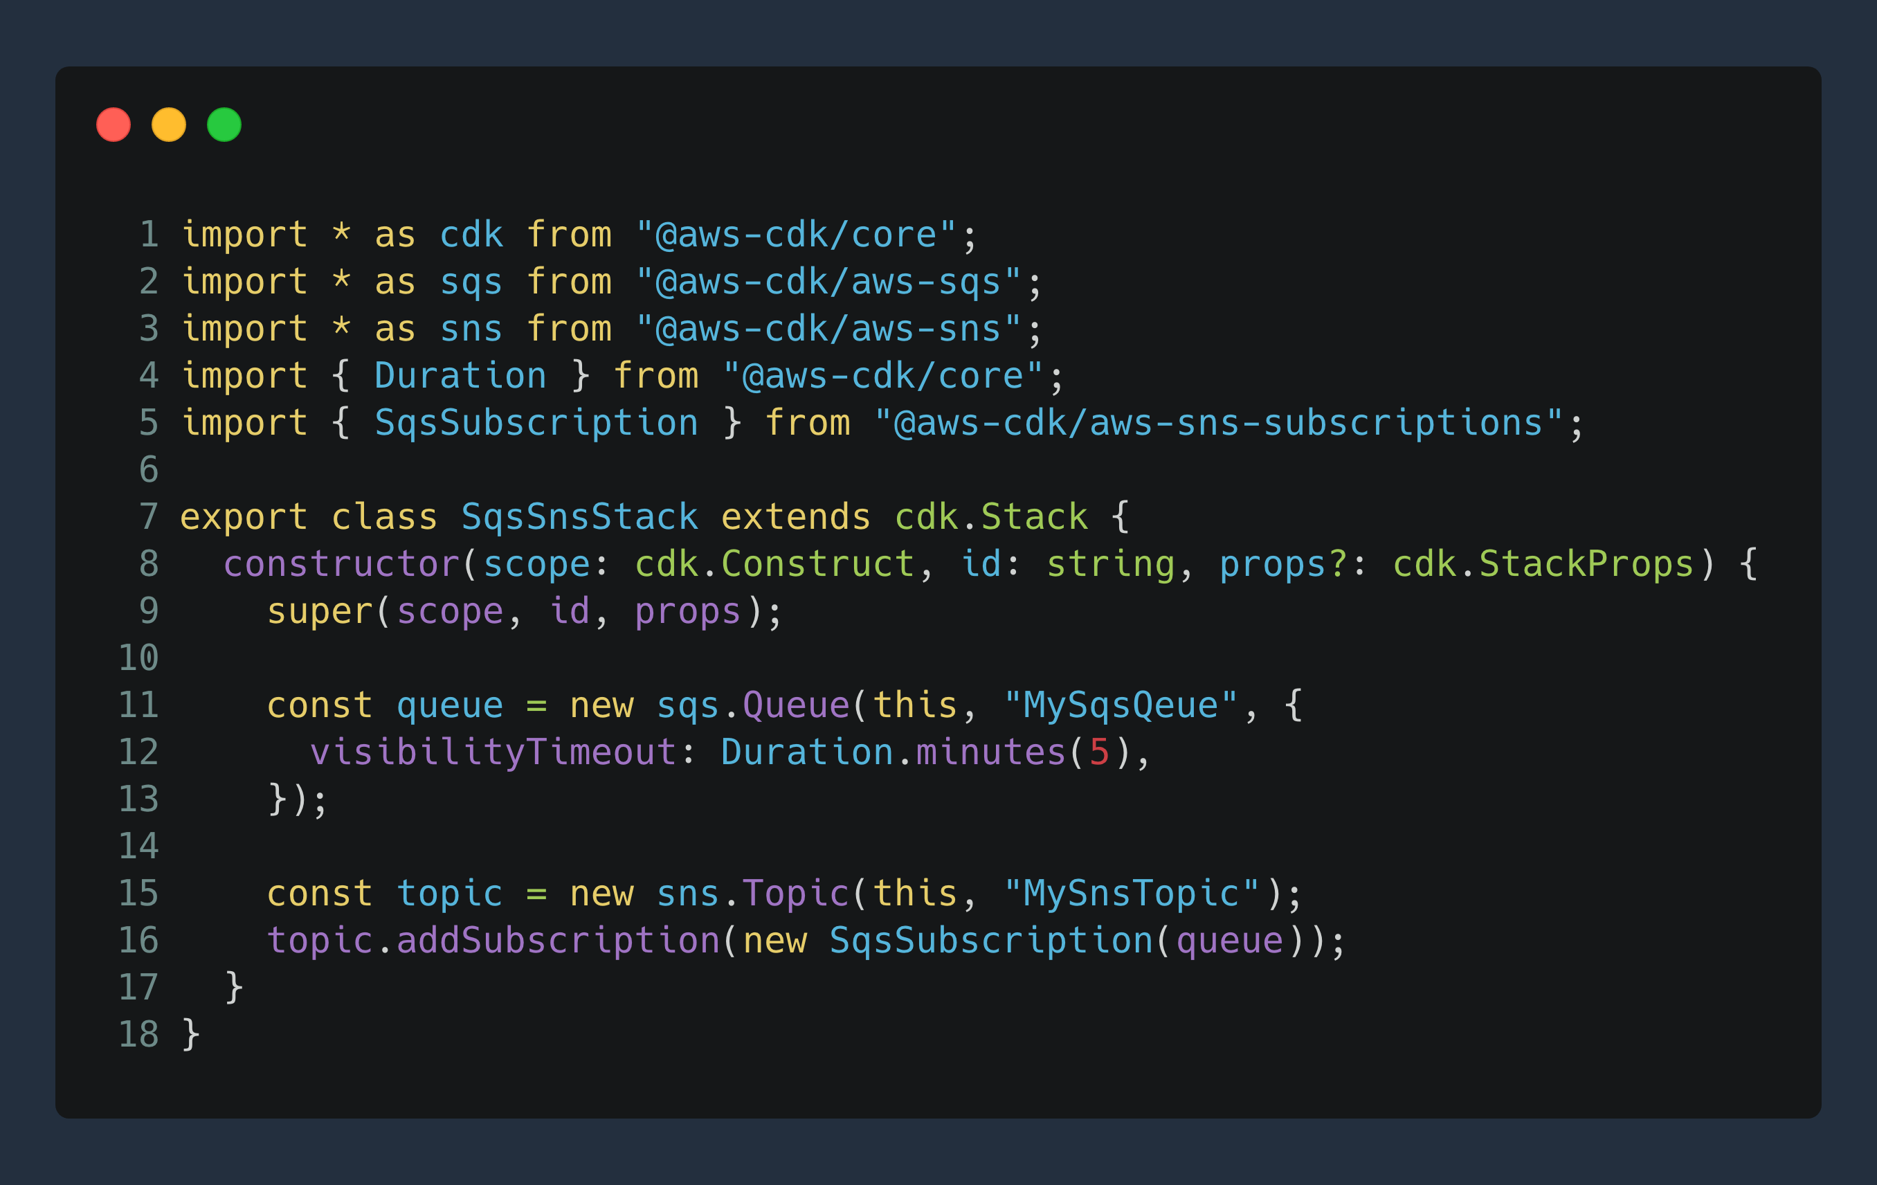
CDK Example
Notes:
Let us take a look at an example.
Here we create a new SQS queue and set the visibility timeout to 5 minutes. Then we create an SNS topic and wire both together by adding an SQS subscription.
Now let’s see how the development flow of CDK is and how we can ship our code.

Slide 10
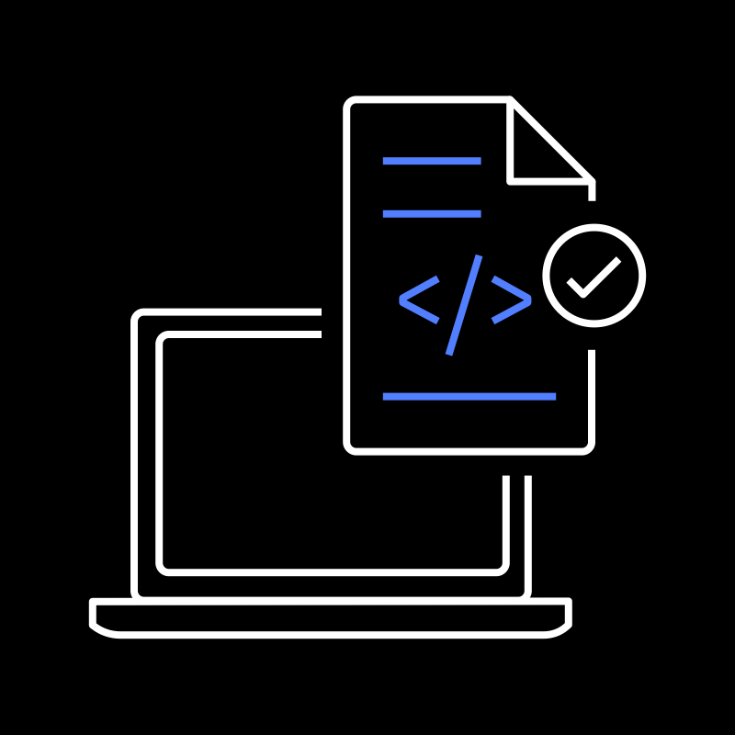
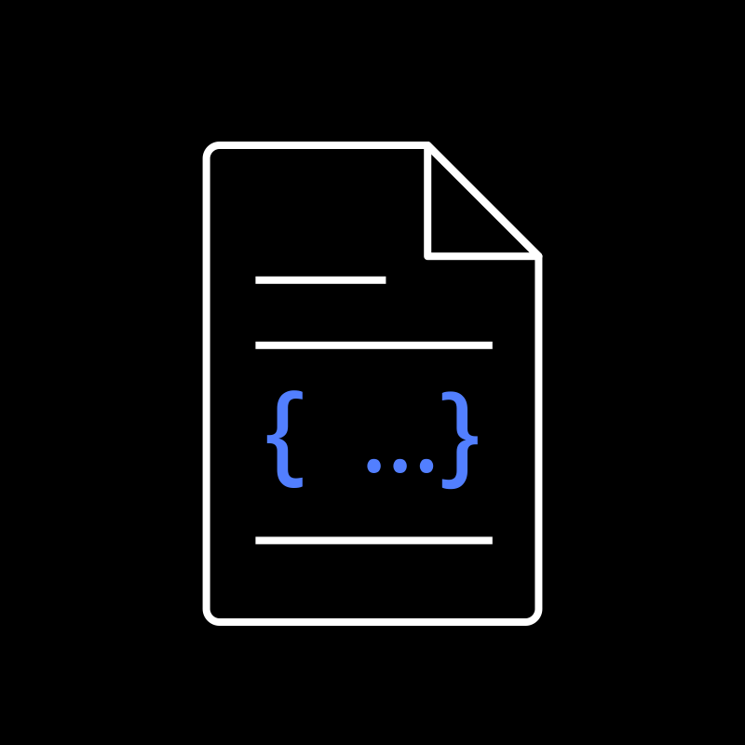


Development Workflow
execute
synthesize
deploy
provision
Stacks & Constructs
Source Code
CDK CLI
Templates + Assets
Cloud Assembly
AWS CloudFormation
Cloud Resources
📙 cdk init // create new project
🛠 npm run build // build project
🧬 cdk synth // create templates and assets
🔎 cdk diff // check what will change
🚀 cdk deploy // push changes to the cloud
Notes:
We start our project by executing cdk init, that will generate a project structure for our specific programming language, and we can start creating our app, add stacks, constructs and resources.
Once we are done we have to build the project, i.e. if we use TypeScript we use the command: npm run build.
Then we need to synthesize our code to cloudformation tempate: we run cdk synth. This will generate CloudFormation templates and assets, we call this bundle “Cloud Assembly”.
Before we deploy, we can inspect what will change if we delpoy this cloud assembly, which resources will be deleted, updated or created.
With ”cdk depoy” we push the changes to the AWS CloudFormation service and from there the service will create cloud resources in our AWS account.

Slide 11


Paradigm Shift
Stack 1
CloudFormation
Parameters and intrinsic functions
Parameterized Template
AWS
CloudFormation
Stack 2
CDK
Stack A
Template A
Typed OO language: loops, conditions, inheritence, etc
CDK App
Source Code
AWS
CloudFormation
Stack B
Template B
Notes:
With CDK we also see a paradigm shift how we provision multiple environments.
Previously with CloudFormation we have used one template with parameters for multipe environments, i.e. dev and test.
With CDK we have a shift where we have multiple tempaltes that are generated for each environment, which end up in different stacks. This decoupling helps us to contain and maintain differences between environments, i.e. have less expensive resources in the dev environment.

Slide 12
CDK Constructs

Slide 13
AWS Construct Library
Serverless
Application Integration / Foundational Services
Containers
CI/CD
Notes:
This slide is transition to the concept of constructs.
The AWS CDK includes the AWS Construct Library, which contains constructs representing AWS resources.
This library includes constructs that represent all the resources available on AWS. For example, the s3.Bucket class represents an Amazon S3 bucket, and the dynamodb.Table class represents an Amazon DynamoDB table.
While this library is a starting point to create resources, one of the big advantages is to have a composition of this services that represents complex infrastructure, such as network setup, clusters, databases.
Let’s take a look at the various levels of constructs and when to use them.

Slide 14
Construct Levels
L3+
Purpose-built constructs
Opinionated abstractions
L2
AWS Constructs
High level service constructs
L1
CloudFormation Resources
Automatically generated
Notes:
The constructs are organised in three different levels:
L1 are constructs that are automatically generated from the CloudfFormation resource specification. This are 1:1 mappings between classes and AWS resources.
L2 are the higher level service constructs to represent resources such as Amazon S3 Bucket or a VPC including other resources, so this can be a composition of multiple resources, but still tied to one service. This constructs are simpler and requires very little input to generate complex CloudFormation templates, they can have many defaults and opinions.
L3+ are opinionated abstractions that are created by AWS i.e. ECS Service with ALB and VPC, or 3rd parties from the community or your own libraries. This is the level where you would create your own abstraction that can be reused.

Slide 15
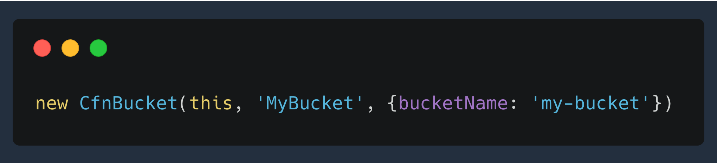
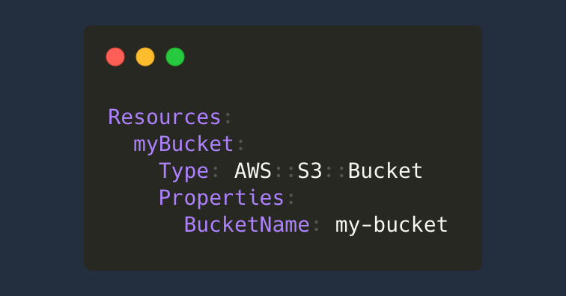
L1
Generated mappings from CloudFormation Specification
abc.CfnXyz → AWS::ABC::XYZ CloudFormation Resource
ec2.CfnInstance → AWS::EC2::Instance
kms.CfnKey → AWS::KMS::Key
🧬 cdk synth
Notes:
Low level constructs have direct access to generated CloudFormation elements.
This provides control but also requires knowledge about the properties of the resource specification.
All fields are optional, CDK tries to generate properties where it can, such as names or well defined defaults.

Slide 16
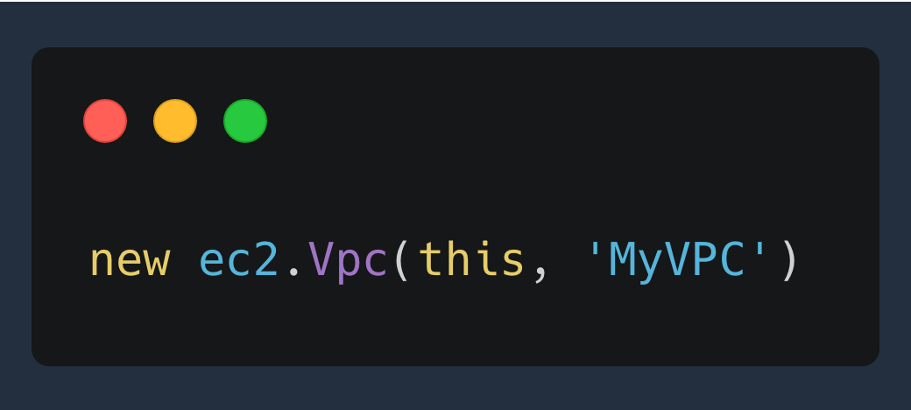
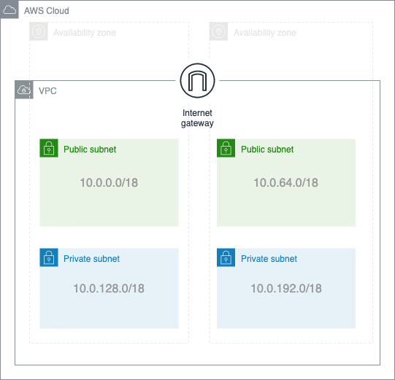
L2
🧬 cdk synth
Ready-to-use VPC setup
65536 IPs split equally between 4 subnets
If you provide a region → adjusted to 3 AZs
Everything is optional, change any parameter
Sane default values
Notes:
L2 can generate more a complex structure, they can contain multiple resources, but they are stil scoped to specific service, i.e. VPC.
With this single line of code we can create a VPC that spans two Azs, 4 Subnets and 65536 IPs splitted qually. We have Internet Gateway, Route Tables etc, everything you need to have a fully configured VPC.
Anyone here who has build a VPC from scratch in CloudFormation? I think you can relate how challenging the setup can be and how long it takes. Here we have a ready to use VPC with just one line, and you can change many options you want and adjust to your requirements.

Slide 17

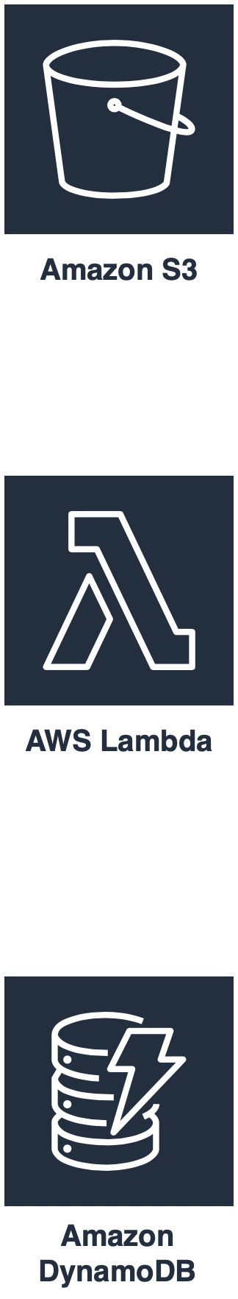
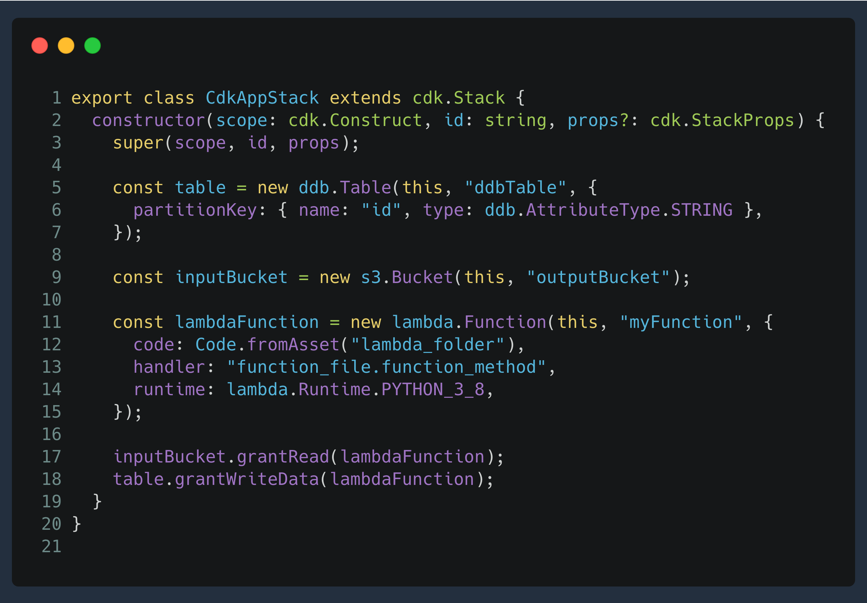
L2
Notes:
CDK also provides abstractions to provide safe and secure permissions.
Here is an an examples:
We want to give a resource a permission to access another resource, i.e. write/read/delete etc. With CDK it is just a one line, calling a ”grantRead” or ”grantWrite” on a target resource. In this example we have
Consider a scenario, where we have a lambda function that takes a file from S3 and writes to a DynamoDB table
With CloudFormation, we would need to create a policy with two separate statements: one for read permissions to s3 and one to write to DynamoDB
Following best practices we should also scope down the policy to specific resources, so only read for specific S3 bucket and write for specific table.
Here we define a table object with one partition key (similar to a primary key) and an S3 bucket, inputBucket
For the Lambda function we have to provide mandatory parameters: code location, in our case in the ”lambda_folder” folder, the functionfile and function name with the dot-notation, and the runtime. Notice the enums we use to set the runtime, this way you don’t have to lookup the strings and can just select the available runtime specifications. If it changes in the future, it will be reflected in code.
Then we just call grantRead and grantWriteData to provide read and write permissions to our lambda function.
With CDK, we use the grant method on both resources, s3 and table, and set the permission programmatically. CDK will generate the correct policies for us
This helps not only to be much faster and secure during development, but also simplifies the thought process for the intent.
Resources in the AWS Construct library has different methods, i.e. add a BucketPolicy, get CloudWatch metrics, addEventSource, and more

Slide 18
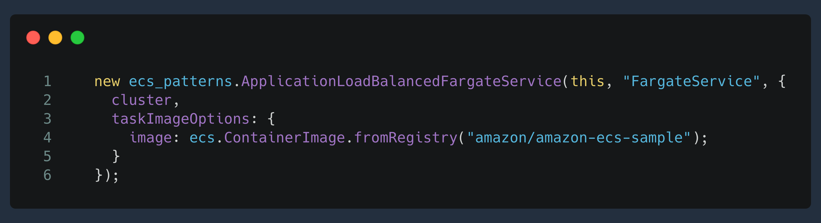






L3
AWS VPC
Elastic Load Balancer
Fargate Service
ECS Task Definition
829 line
CloudFormation
template
Subnets
EIP
NAT Gateways
Internet Gateway
Route
Route Table
Security Group
Security Group Egress
Security Group Ingress
Task Definition
Listener
Target Group
IAM Roles
IAM Policies
Log Group
Configuration
image
CPU
memory
port
“amazon-ecs-sample”
image
Notes:
L3 constructs are componsition of resources across different services.
In this examples that have seen before, we create an ALB with corresponding security groups, task defintions, listeners etc. We also create a Fargate Service with IAM Roles and Policies, Log Groups and Task Definitions, by just providing two paramteres: an ECS cluster and the name of the docker image from public dockerhub repository.
This show how powerful L3 constructs can be and you can create your own abstractions that others can, either publically or privately within your organisation.

Slide 19


CDK stability index
Notes:
CDK construct library is quite modular and some constructs might be actively developed while others are quite stable. We communicate the current development for each construct in our documentation and our release notes. Here is what each of them means:
Experimental:
under active development.
subject to non-backward compatible changes or removal in any future version.
while you may use them, you may need to update your source code when upgrading to a newer version of this package.
Developer Preview:
this module are in developer preview before they become stable.
We will only make breaking changes to address unforeseen API issues.
breaking changes will be announced in release notes.
while you may use them, you may need to update your source code when upgrading to a newer version of this package.
Stable:
The module is generally available with a compatibility guarantee across minor versions.
We will only make backward-compatible changes to the API, so that your existing apps will continue to work until the next major AWS CDK release.
In some cases, we may use feature flags to optionally enable new behavior while retaining the previous behavior to support existing apps.

Slide 20
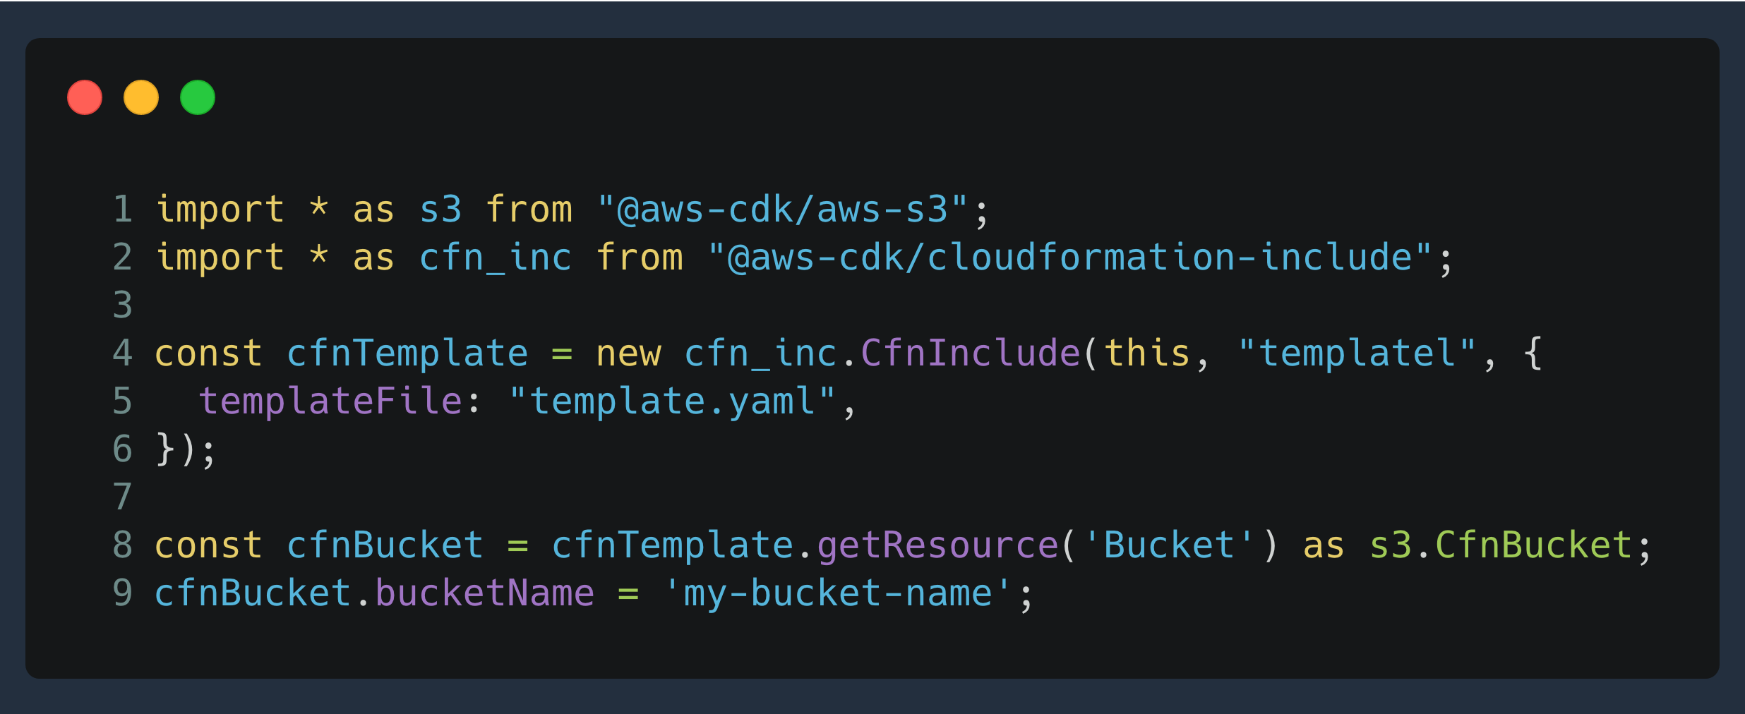
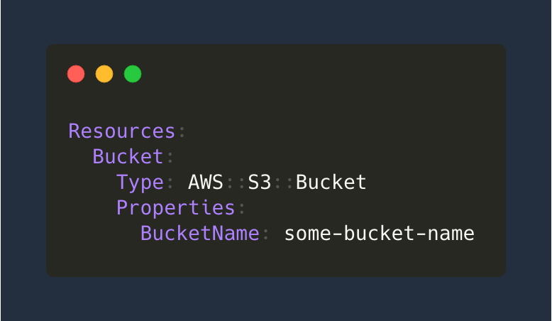
Import CloudFormation Templates
Notes:
Many customers have already built lots of CloudFormation templates and we have created a construct that helps you to import your existing templates, adjust and reuse them. This is should help to transition to CDK without rewriting too much infrastructure as code from YAML/JSON to code.
In our example we have an existing cloudformation for an S3 Bucket and we use CDK to import this template by providing a file path. After that we can access the bucket by using its logical name, in our case “Bucket” and change any property. As you can see this object will be a L1 construct, so keep in mind that you don’t have access to all the methods that you might use in L2 constructs.

Slide 21
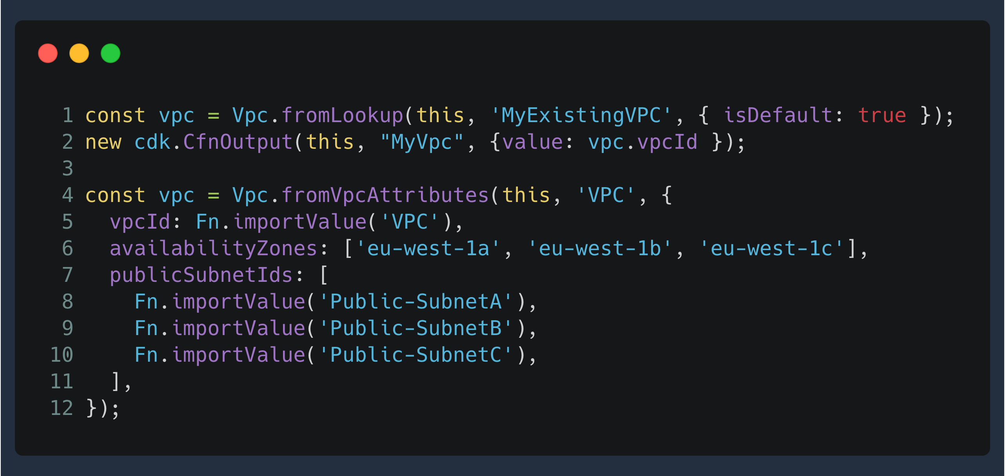
Import existing resources – fromX()
Notes:
In many cases some resources are not created from scratch but provided by different teams and are out of control, so we need to import them.
Existing resources can be referenced in CDK by calling the Construct’s fromXXX() method. They often need ARNs or Ids which can be imported from existing CloudFormation Stacks.
Just Vpc.fromLookup() is a special case as it reads the values from your AWS account during cdk synth and stores them in ‘cdk.context.json’.
Keep in mind that this imports are not environment agnostic, they are tied to specific accounts and setup.

Slide 22
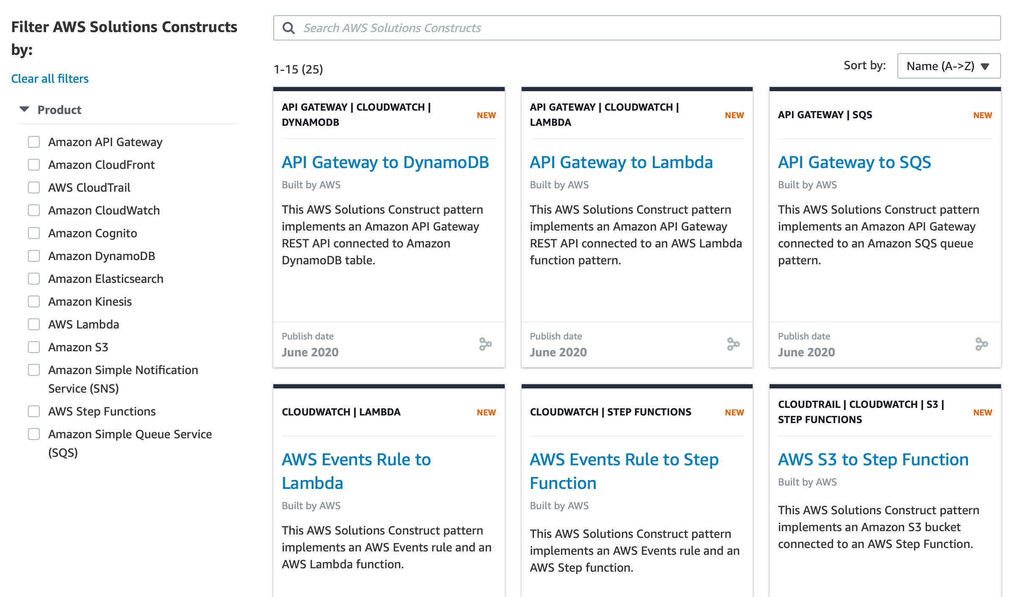
L3 - AWS Solutions Constructs
Notes:
AWS Solutions Constructs are vetted architecture patterns, available as an open-source extension of the AWS Cloud Development Kit (CDK), that can be easily assembled declaritively to create a production-ready workload. Below you will find a directory of the patterns made available through AWS Solutions Constructs.
This is a growing library of best practice architectures, that you can filter to find the right solution for your use case.

Slide 23
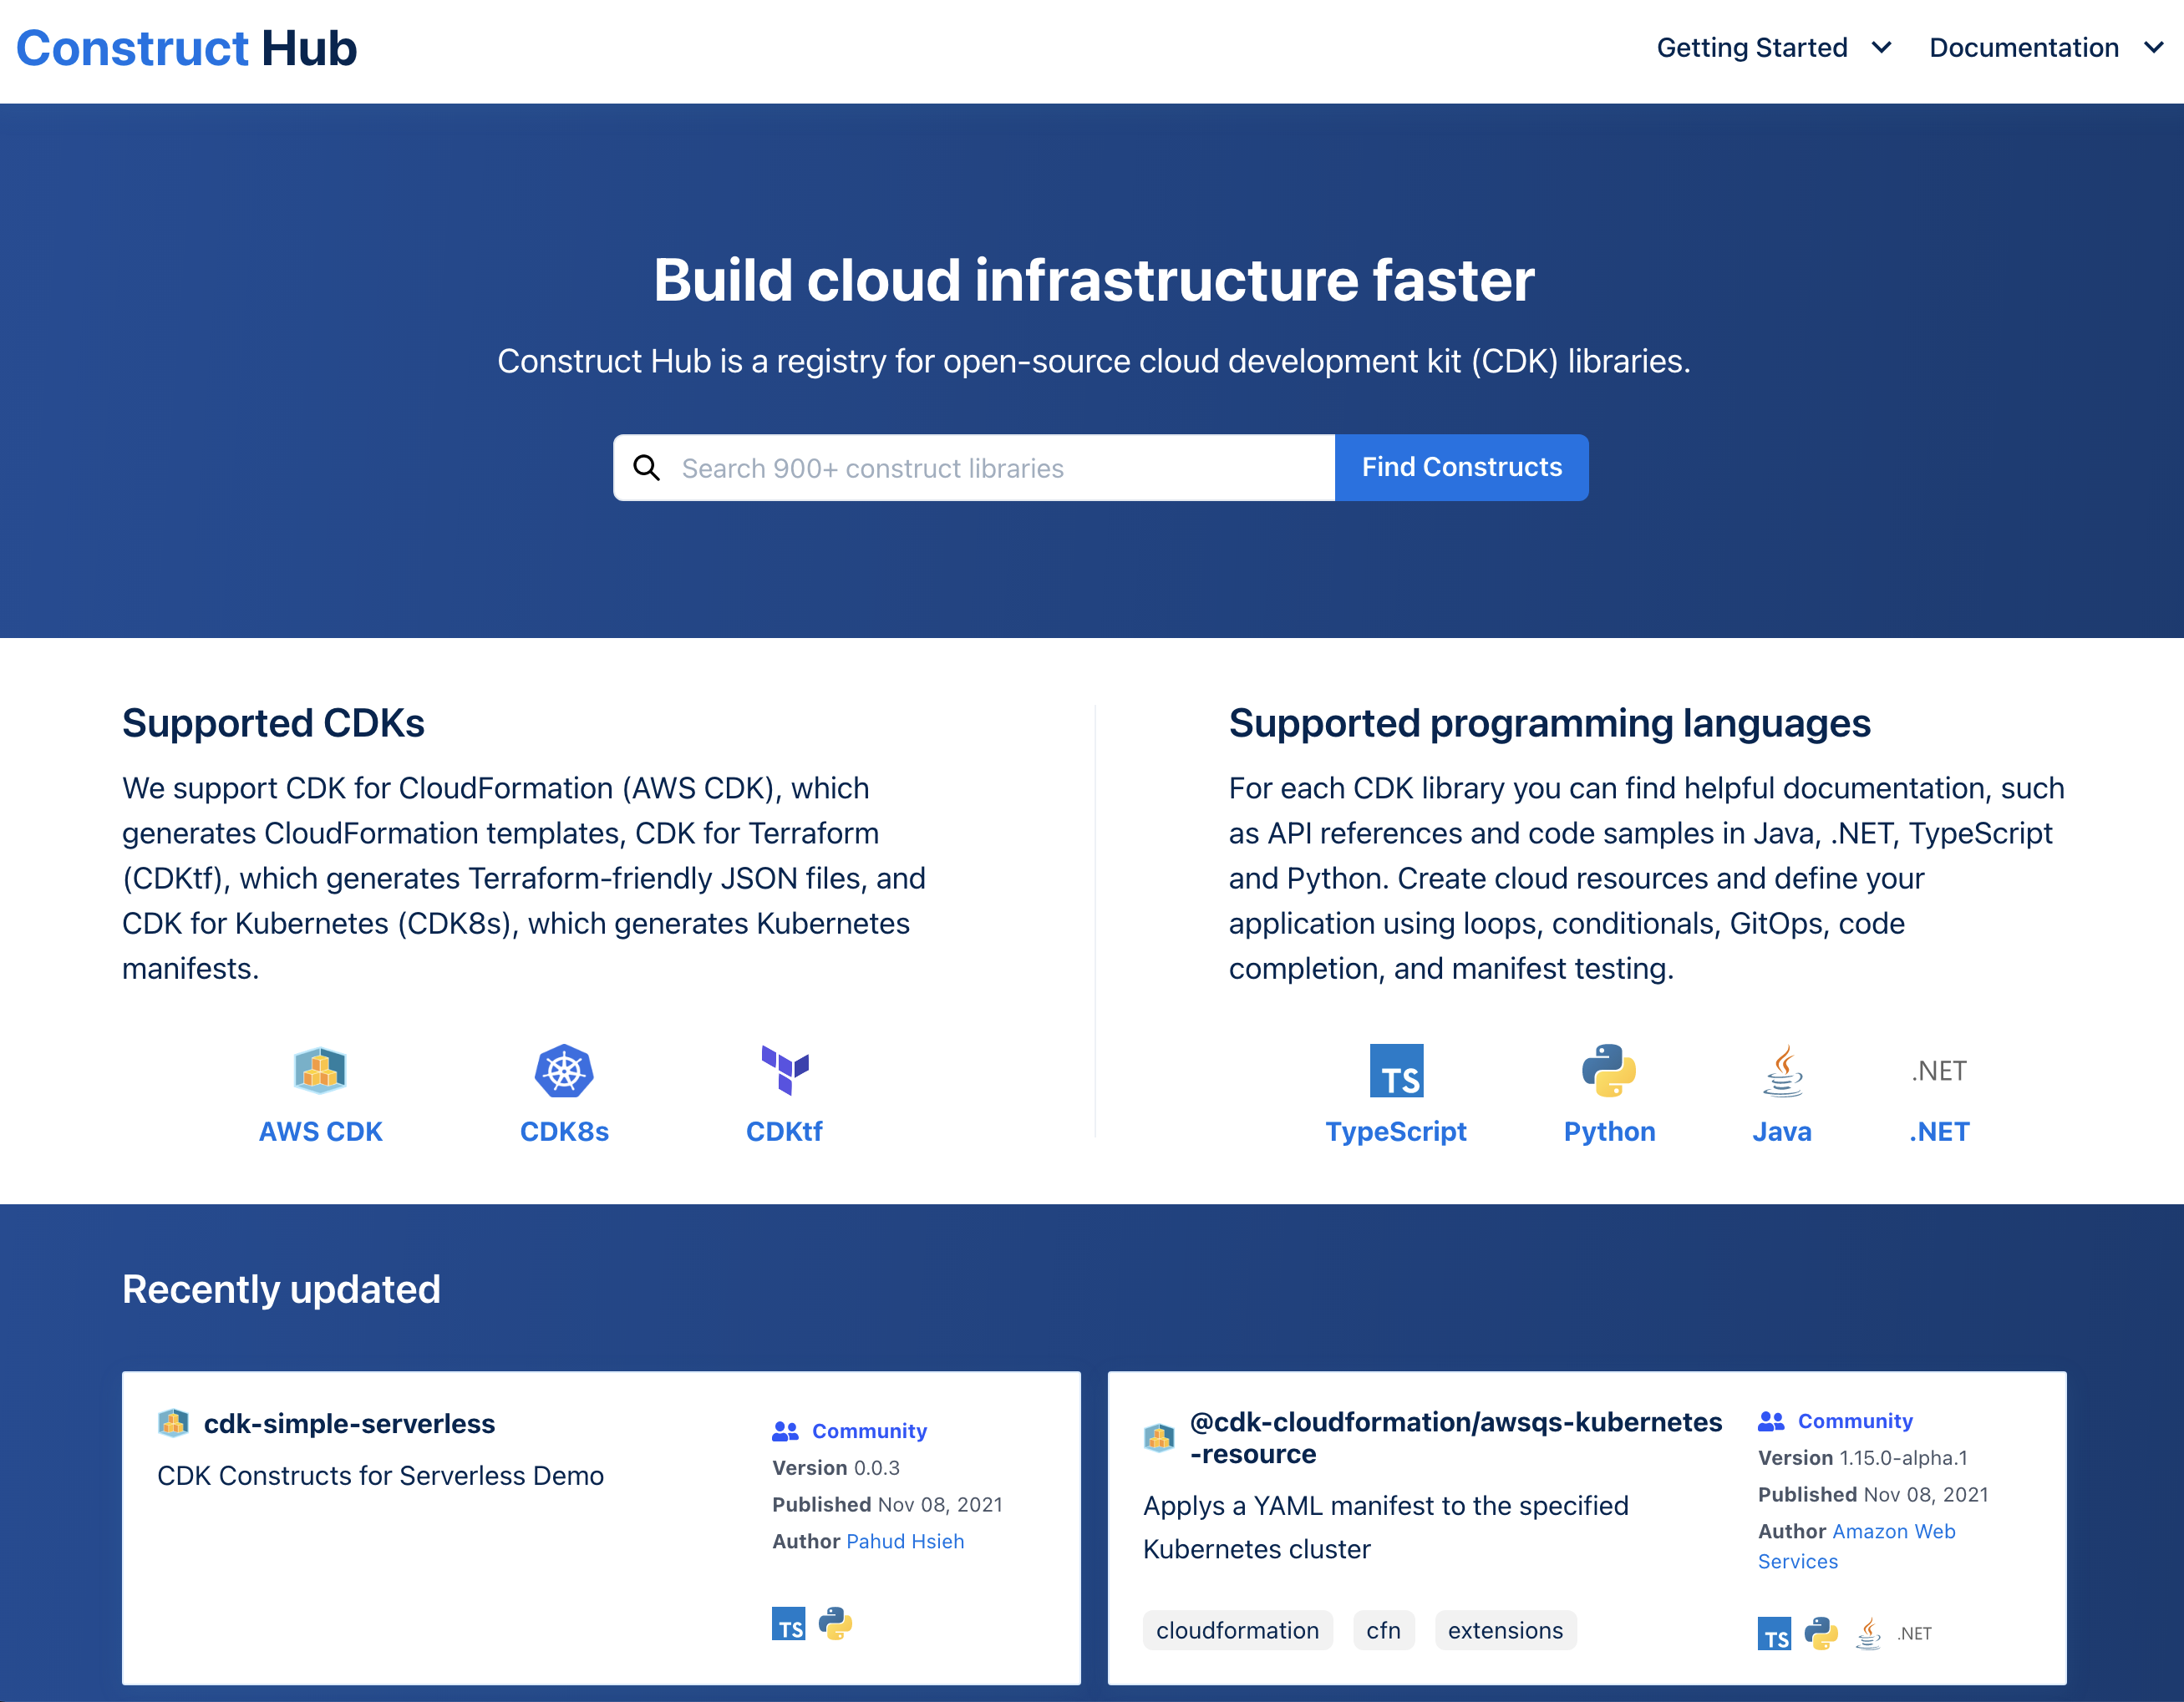
L3 – constructs.dev
Notes:
We have also a community driven construct hub under constructs.dev where you can publish your CDK constructs.
Additionally, the hub itself is a construct that you can host privately for your enterprise, so you can have your company wide construct hub!

Slide 24
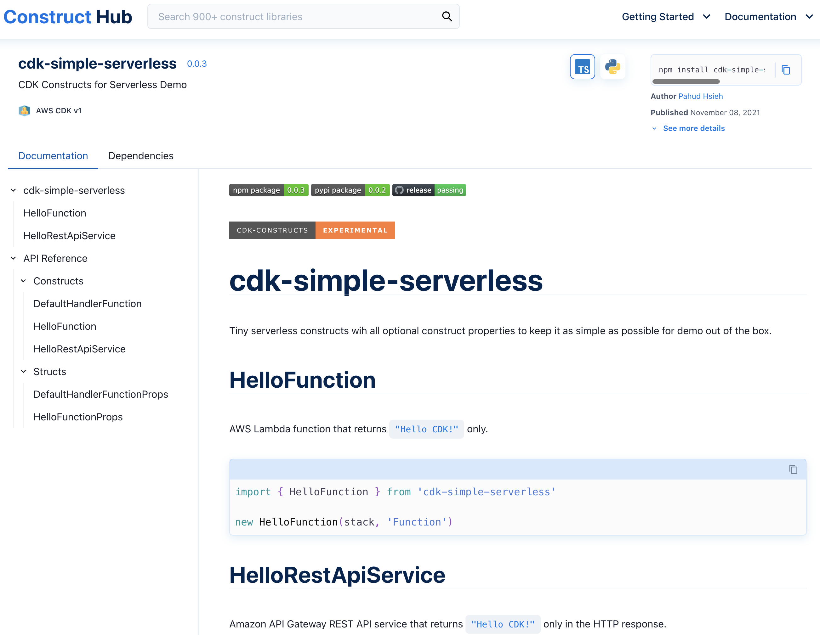
L3 – constructs.dev
Notes:
We have also a community driven construct hub under constructs.dev where you can publish your CDK constructs.
Additionally, the hub itself is a construct that you can host privately for your enterprise, so you can have your company wide construct hub!

Slide 25
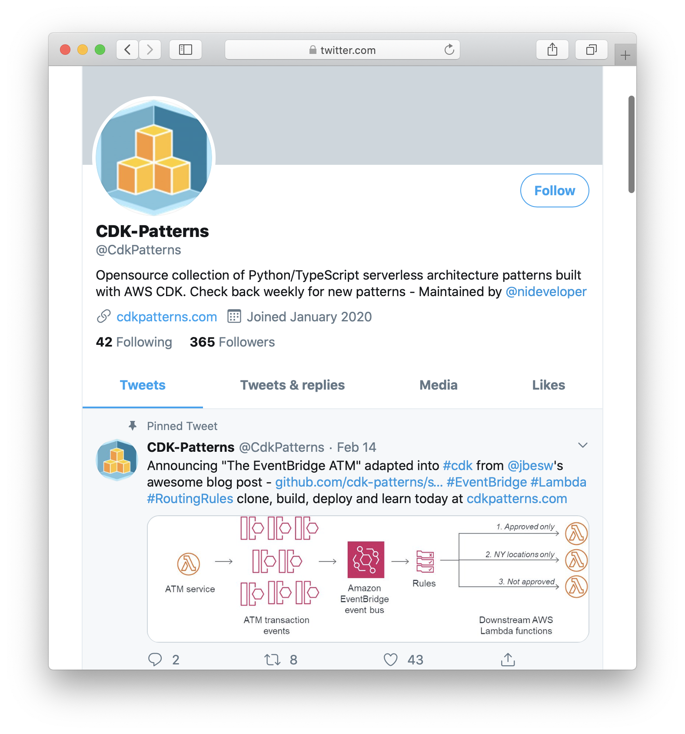
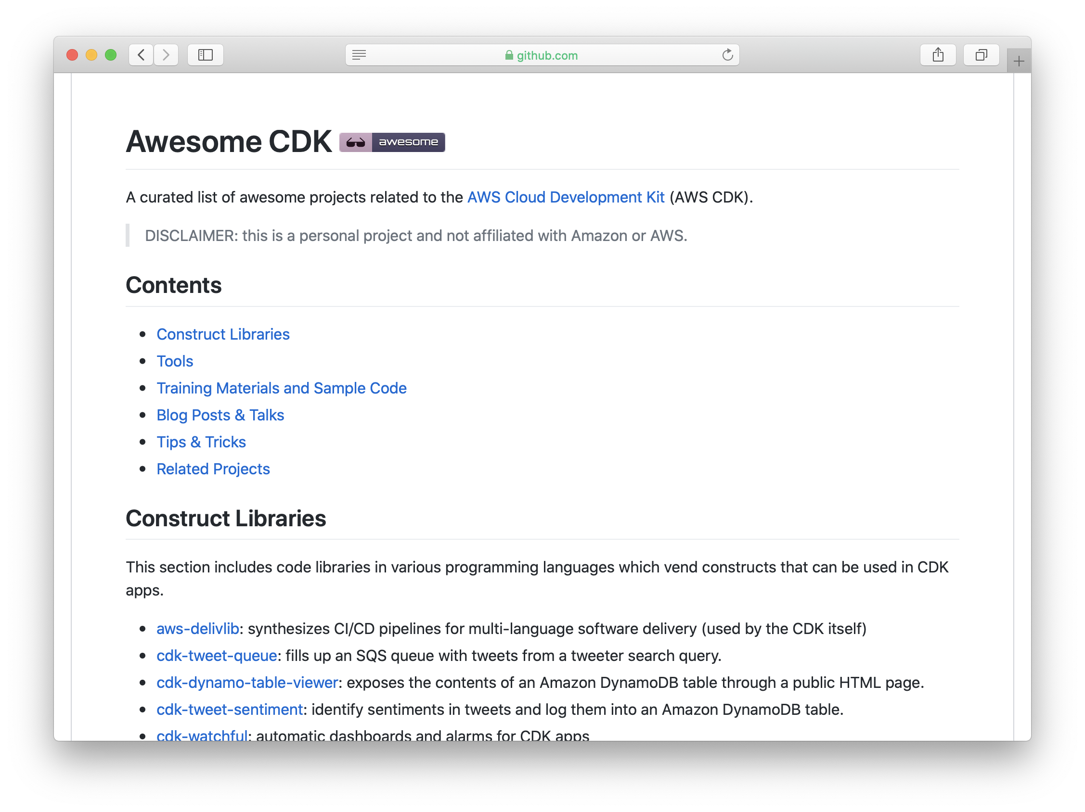
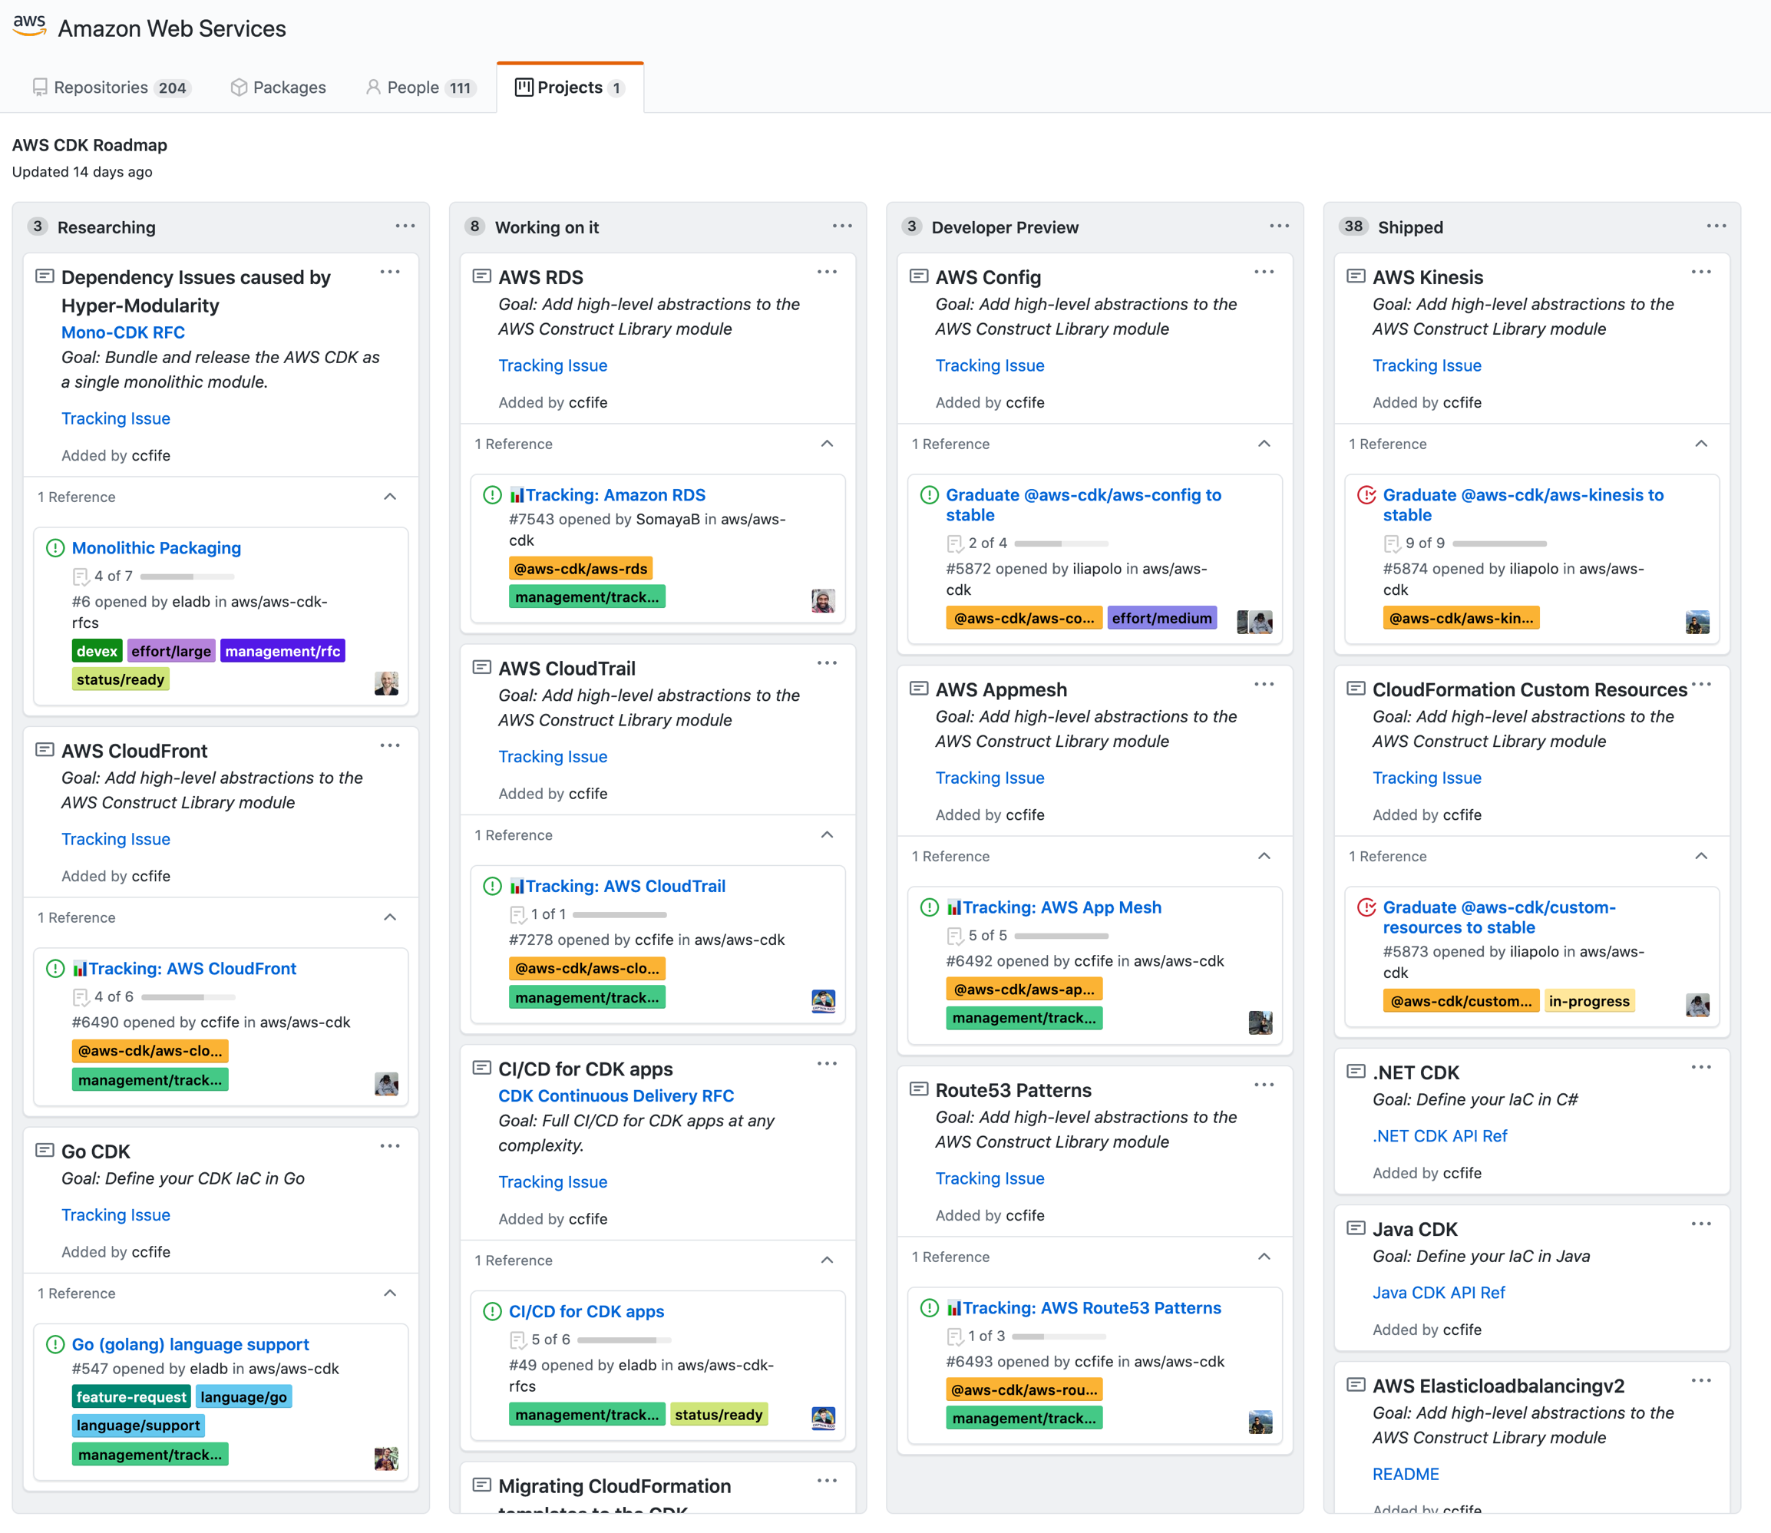
Open Ecosystem
Notes:
AWS CDK is an open Ecosystem, we have public roadmap to show what features are prioritized by customer feedback. We are happy to have many contributions from the community and would love to have your voice in future development of the tool.
There are also many other resources that you can found in Awesome CDK repository and a collection of 3rd party L3 construct libraries in @CdkPatterns. Feel free to inspect how others are building service compositions.

Slide 26
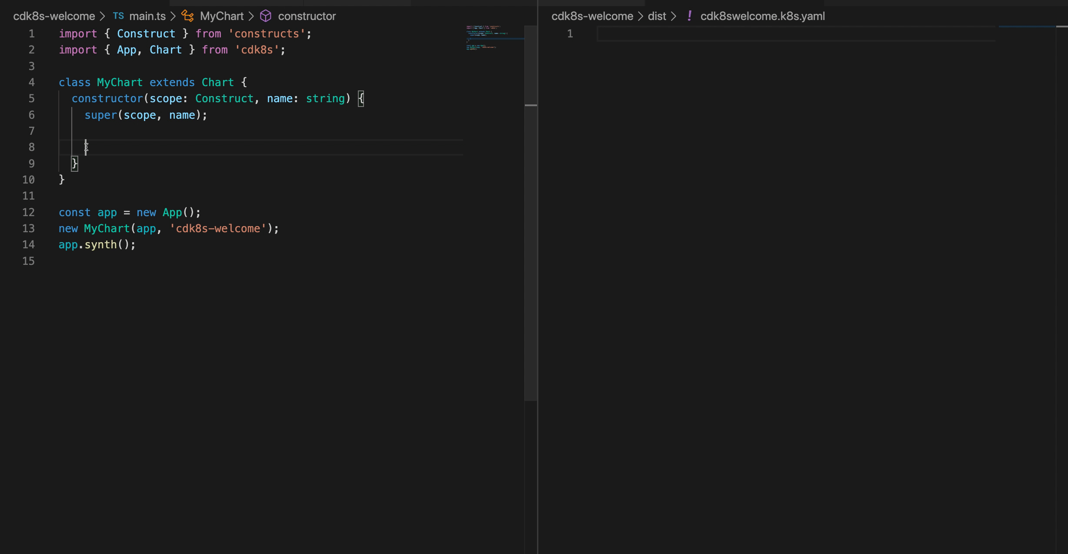
cdk8s.io
Notes:
cdk8s is an open-source software development framework for defining Kubernetes applications and reusable abstractions using familiar programming languages and rich object-oriented APIs. cdk8s apps synthesize into standard Kubernetes manifests which can be applied to any Kubernetes cluster.

Slide 27
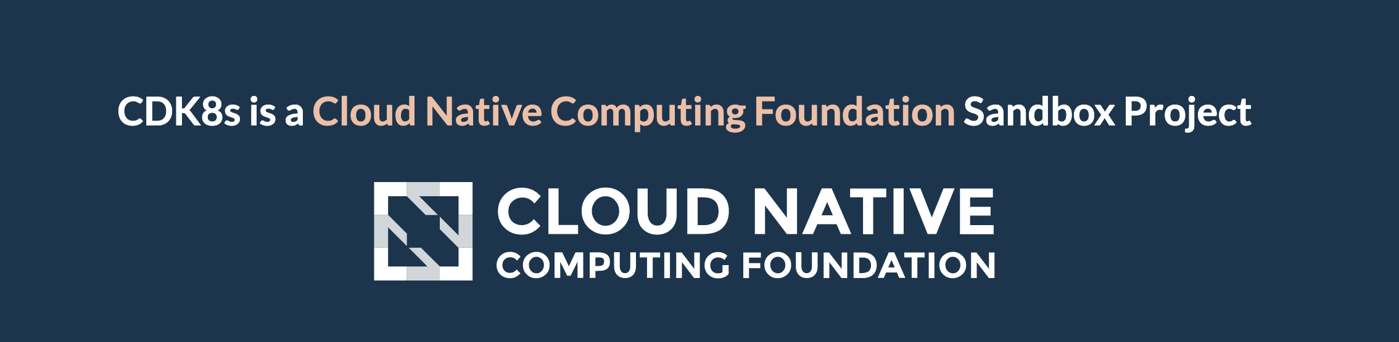
cdk8s.io
Notes:
cdk8s is an open-source software development framework for defining Kubernetes applications and reusable abstractions using familiar programming languages and rich object-oriented APIs. cdk8s apps synthesize into standard Kubernetes manifests which can be applied to any Kubernetes cluster.

Slide 28
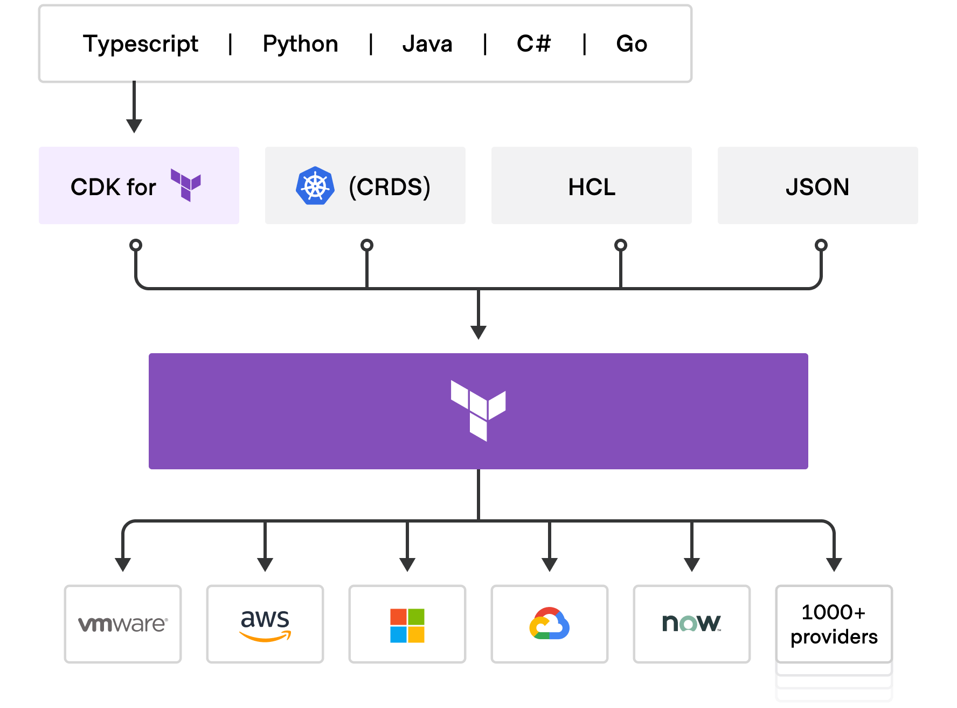
Terraform Support
Notes:
We are also working closely with Hashicorp and have released a developer preview of CDK-TF. You can write your CDK constructs and use Terraform as provisioning engine.

Slide 29
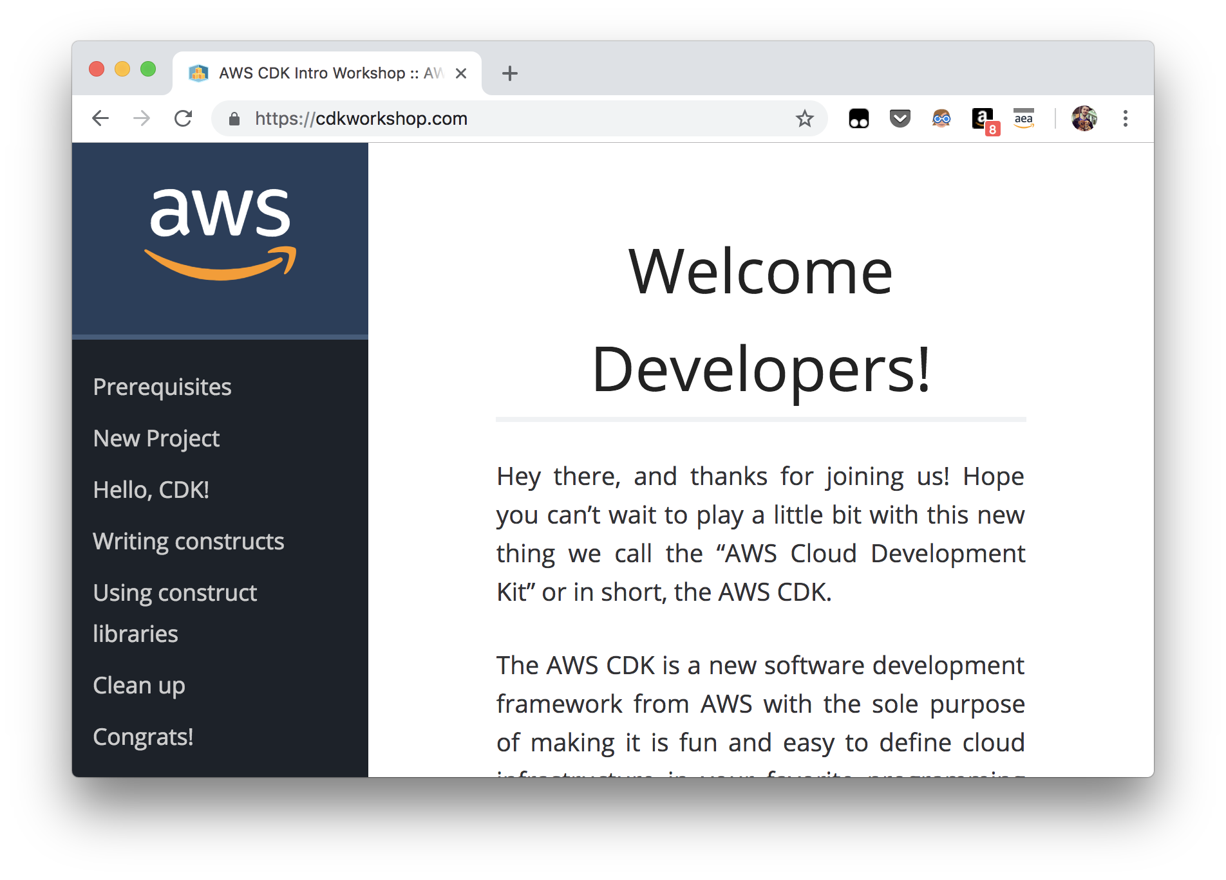
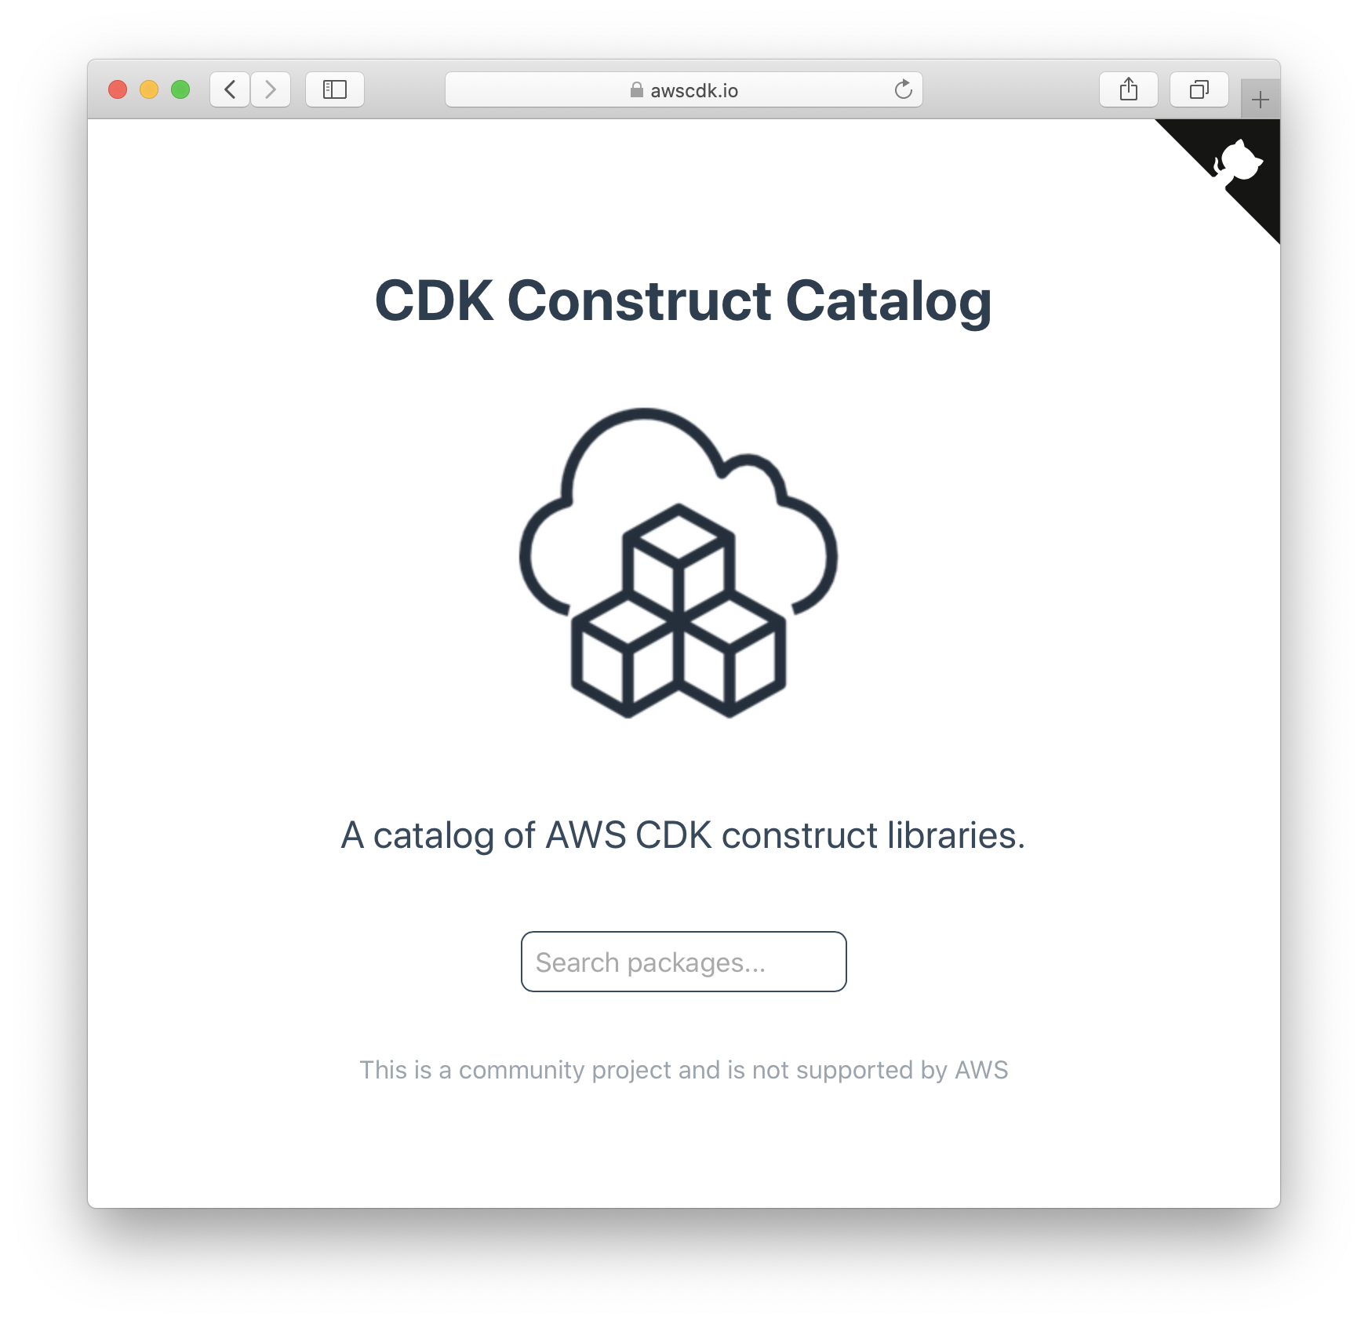
Try it out
Get started
cdkworkshop.com
aws.amazon.com/cdk
aws-samples/aws-cdk-examples
Contribute
gitter.im/awslabs/aws-cdk
aws/aws-cdk
aws/jsii
Community Resources
cdkpatterns.com
cdk8s.io
awscdk.io
eladb/awesome-cdk
Notes:
There are also plenty of resources out there if you want to start with CDK, such as cdkworkshop.com, cdk-examples and many more.
Feel free to drop by in our gitter channel if you have any feedback or questions, we are happyt to support you there.
Thanks for being with me, we can now take few question during the Q&A.

Slide 30
Q&A
Name

Slide 31
Backup Slides

Slide 32
Build Custom L3 Constructs
Notes:
We will take a look first at what are the good candidates to build an L3 construct, dive deeper into how the development looks like.

Slide 33
Use Cases
Custom defaults
S3 Bucket: kms encrypted, bucket policy
VPC: custom subnet, IP ranges, service endpoints, firewall rules
Lambda: prebuild layers
Service Composition
SQS Monitored: two queues, one dead letter, with sns notification
ECS Cluster: custom cluster setup
S3-Lambda-S3: event driven data processing
CI/CD Pipeline template
Notes:
What are good use cases to build your custom constructs?
In general
Use L3 for your own defaults, based on your team/company/client requirements
Or complex setup requires few inputs: hosting static website
For example if you need constructs with custom defaults that should be used across the teams, such as kms encryptions or bucket policies.
Maybe you have a very specific VPC design that you want to adopt across many teams. This can still provide flexibility to change properties, and provides a safe way to have a ready to use resources within an organisation.
Service Composition is another set of use cases. We have seen the ApplicationBalancedFargateService as an example. Maybe you have your own design you want to adopt and reuse? You can create your custom L3 constructs for that.
Another example is to have an SQS with lightweight monitoring capabilities. You typically want to have a dead letter queue where all the unprocessed messages will be rerouted and a notification mechanisms with SNS that sends an email, when something went wrong. This is a simple example where you can build your own construct and use just queue names and email address an an input.
CI/CD template can also be very useful. Many of us have copied Jenkins job files or Gitlab pipeline files across various projects. This is a common way to reuse previous artefacts. With L3 custom constructs we can provide a secure and reliable code library to generate CI/CD pipeline with minimal input.
Now let’s take a look how the development flow of a custom construct looks like.

Slide 34
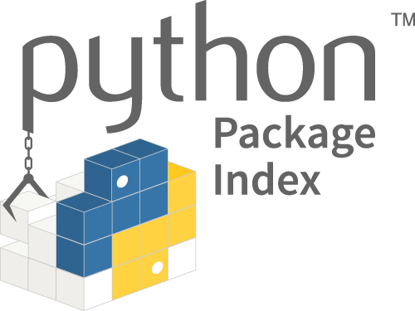
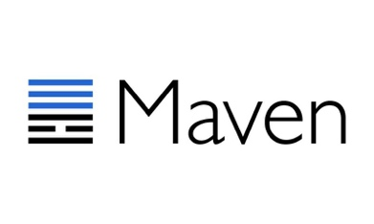
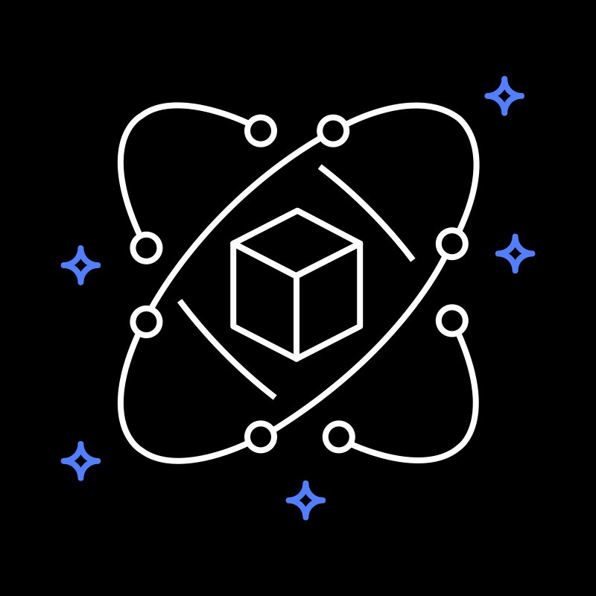
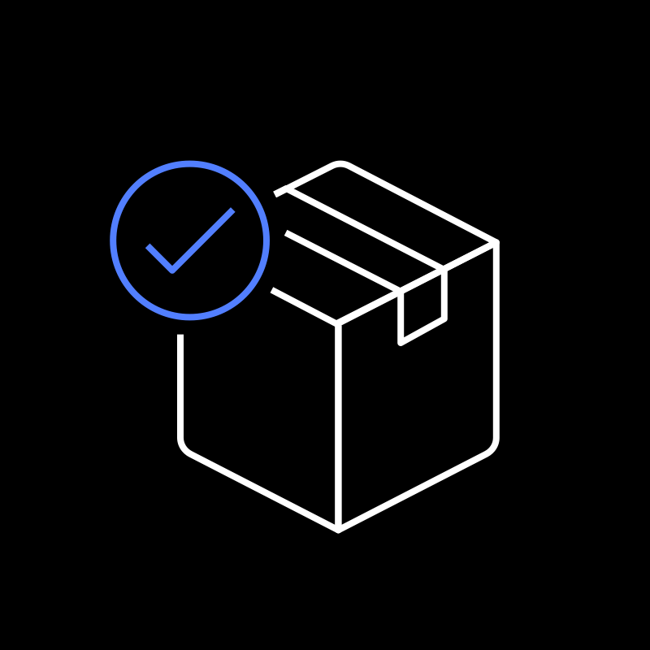



Development flow
add
package
push
pull
Write Code
Source Code
Configure Jsii
package.json
Generate Code
Binary packages
Publish Packages
Code Repository
Use Package
Declare Dependencies
Notes:
Let’s see how the development flow looks from the high level perspective, we will dive into each step and see the code and configuration end-to-end.
First, we need to write our code and test it. Custom constructs are written in typescript.
Once we have our design done, we need install and configure JSii tool, that helps us to generate code packages of our custom construct library. For that we add specific configuration to the file package.json, that we will see later in the following slides.
After we have generated the language specific packages with additional metadata, this packages are ready to published in their respective repositories, such as pypi, maven repo, npm or nuget (pronounced “new get”).
Other developers can now specify the library as a dependency in their project and let the package manager pull the binaries from the repository, just like they did before with other libraries.

Slide 35
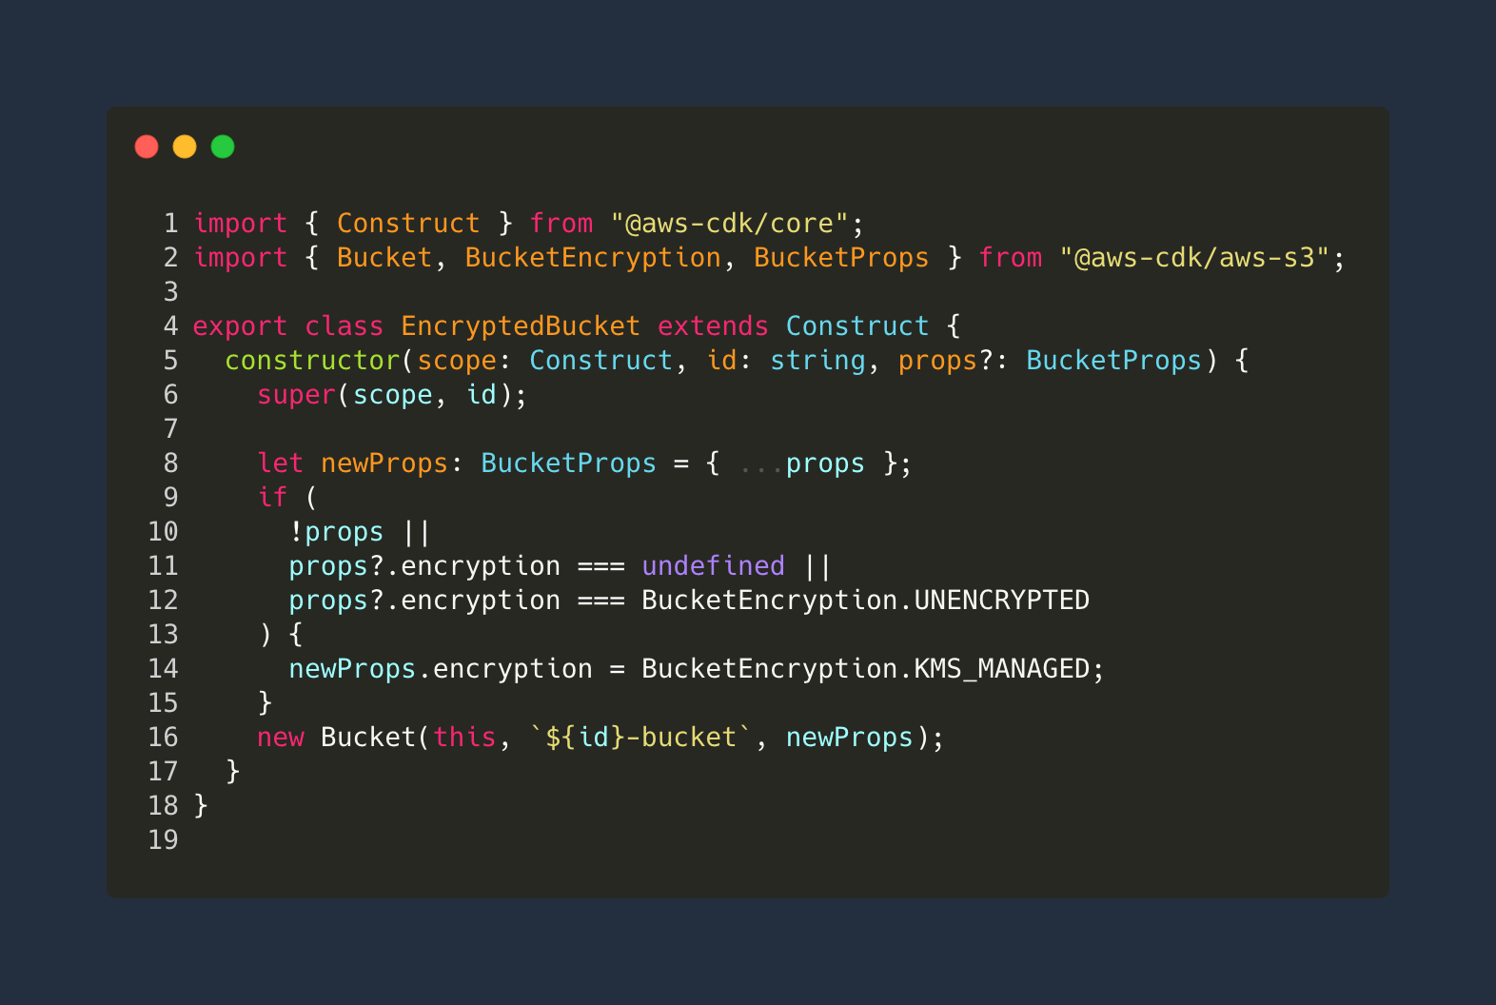
Write Code
Notes:
Here is an example of an L3 construct “EncryptedBucket”, where we want to have an S3 bucket that is encrypted by the AWS Key Management Service.
First we create a class and extend the Construct class from the core framework of cdk.
In line 9 to 12, we check if the properties are set and wether the encryption property is undefied or were explicitly set to UNENCRYPTED.
We overwrite this value with KMS_MANAGE property and create the new bucket.
Let’s see how we can tests it.

Slide 36

Test Code
Notes:
In our test we create a mock app and a test stack.
Now in line 10 we create our custom construct and set the encryption property to UNCENCRYPTED.
We expect that once the code is synthesized, the CloudFormation Resource of S3 Bucket will contain the BucketEncryption with corresponding SSEAlgorithm ”aws:kms” in line 19.
This is just one test, we should also add test confirms the output when we did not set any property or when the encryption is undefined.

Slide 37

JSii Configuration in package.json
Notes:
Now that we our code and tests in place, we need to configure JSii, by putting ”jsii” property into package.json file.
This property contains the output directory where the binary packages should be written to and which target langauges we want to have.
In our case we want to have python and java, for that we need to provide language specific package properties, such as module name for python or groupId/artifactId for maven.

Slide 38
Package & Publish
twine upload
pypi.org
Python wheel
jsii-pacmak
mvn deploy
Jsii Metadata
.jsii
Jar file
Maven Central
npm publish
tgz file
npm.org
Notes:
Once we execut “jsii” it will read the package.json configuration and create separate config file called “.jsii”
Now we run the command to generate binary package: jsii-pacmak, which will output python wheel, a jar file and a tgz file into our dist directory.
From here the developer needs to upload the binary packages to their repository. This can be public repos such ask pypi.org, maven central or npm.org, or it can also be a private repository such as Nexus or Atrifactory.

